Slide 1
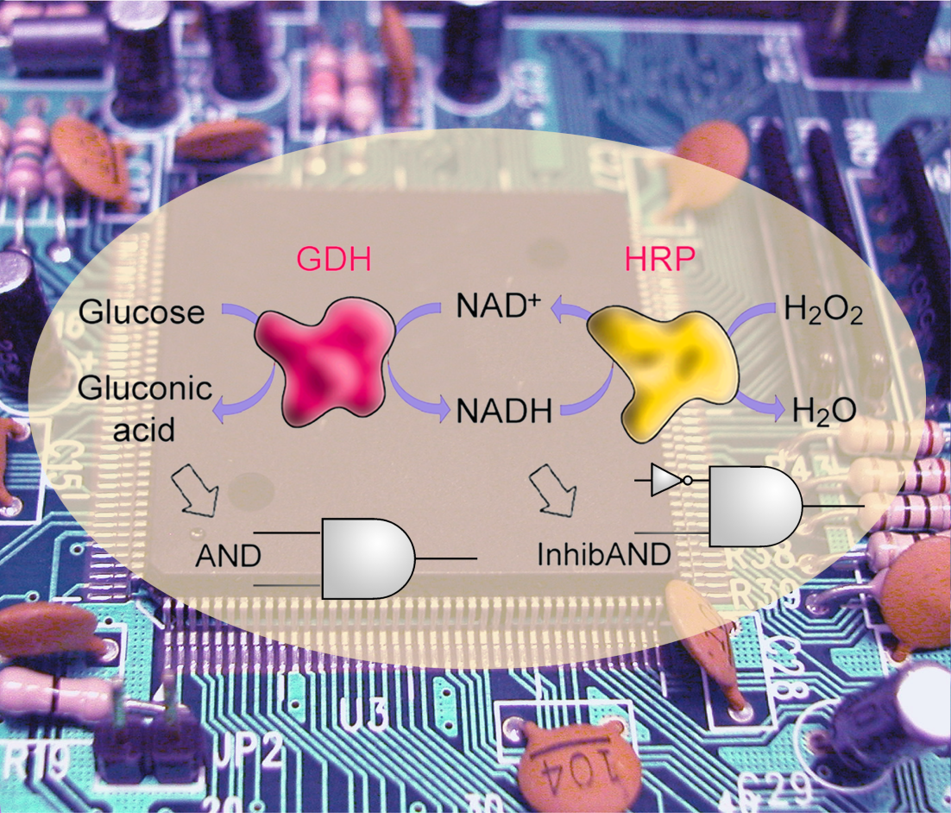
Bioelectronics: From Novel Concepts to Practical Applications
Evgeny Katz
Department of Chemistry & Biomolecular Science, Clarkson University, Potsdam, NY, USA
CoSMoS Annual Conference – September 11, 2012

Slide 2
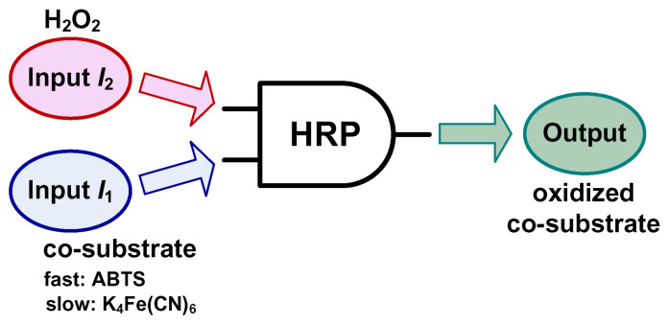
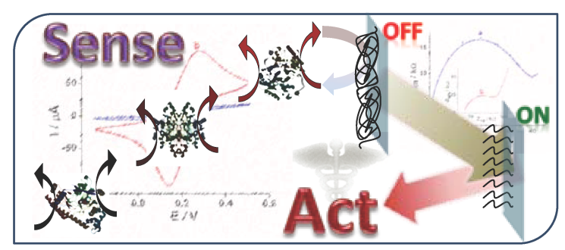
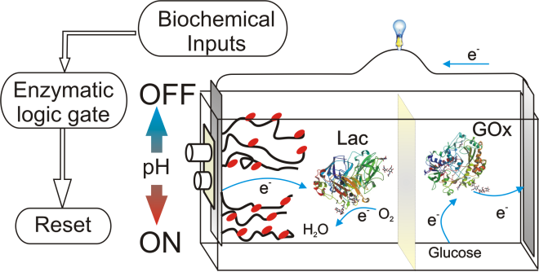
Scientific activities overviewed in the lecture:
Biocomputing (biomolecular computing): Enzyme-logic gates and their networks.
Biosensors and bioactuators – Multi-signal chemical devices integrated with biocomputing systems.
Biofuel cells – "Smart“ biofuel cells controlled by biochemical signals and implantable biofuel cells.

Slide 3
Unconventional computing
Unconventional Computing
Chemical Computing
Computing with Sophisticated/functional molecules
Biomolecular Computing
Enzymatic Computing
Information Processing based on enzyme-catalyzed biochemical reactions

Slide 4
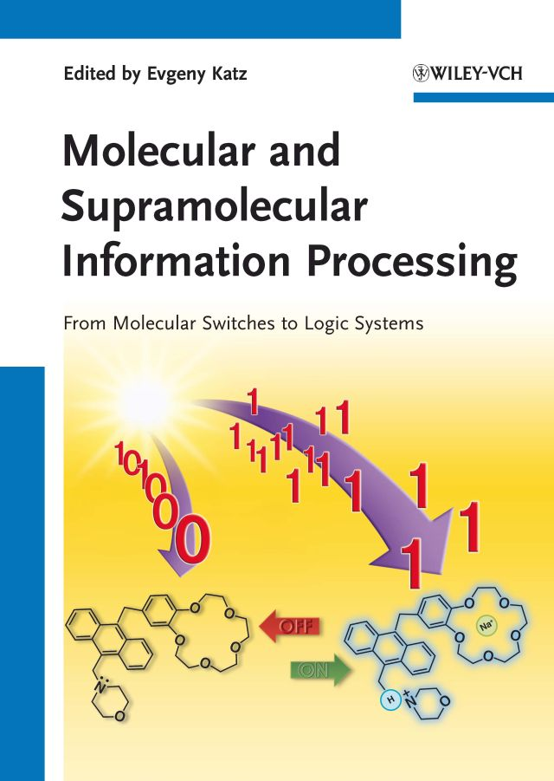
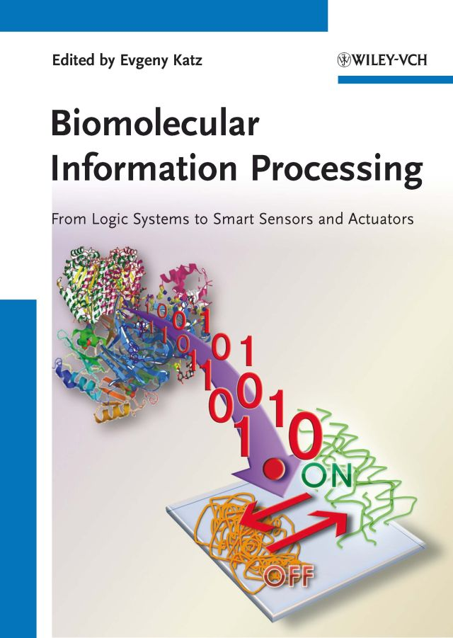
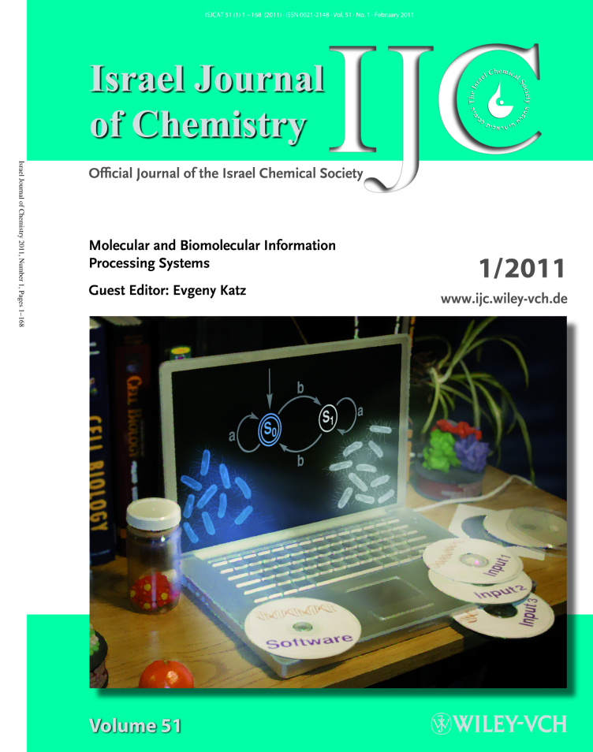
Chemical computing is a subarea of unconventional computing
Books and a journal special issue recently overviewed the molecular computing:

Slide 5
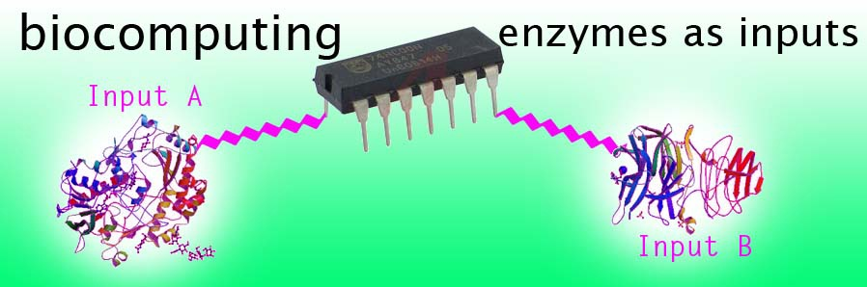
Logic Gates & Elementary Computing by Enzymes

Slide 6
Logic Gates & Elementary Computing by Enzymes
Input 2
AND Gate
Biocatalytic reaction
Product
Biocatalytic reaction
Output
Input 1
Input A
Input B
Glucose
O₂
H₂O
ABTS
GOx
MP-11
H₂O₂
ABTS_{ox}
Gluconic
acid
Output
Digitalization of chemical signals
Input A | Input B | Output
0 | 0 | 0
0 | 1 | 0
1 | 0 | 0
1 | 1 | 1
“1”
undefined
“0”
0,0 0,1 1,0 1,1
G. Strack, M. Pita, M. Ornatska, E. Katz, ChemBioChem 2008, 9, 1260–1266

Slide 7
Logic Gates & Elementary Computing by Enzymes
OR Gate
Input 1
Biocatalytic reaction
Output
Input 2
Input A
Input B
Glucose
NAD⁺
Ethanol
GDH
ADH
Gluconic
acid
NADH
Acetaldehyde
Output
Digitalization of chemical signals
Input A | Input B | Output
0 | 0 | 0
0 | 1 | 1
1 | 0 | 1
1 | 1 | 1
“1”
undefined
“0”
0,0 0,1 1,0 1,1
G. Strack, M. Pita, M. Ornatska, E. Katz, ChemBioChem 2008, 9, 1260–1266

Slide 8
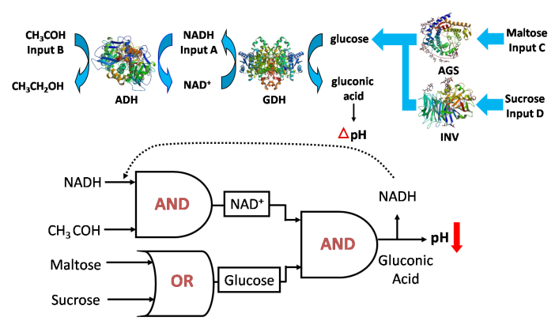
ENZYME LOGIC GATES AND NETWORKING
AND
AND
OR
T.K. Tam, M. Pita, M. Ornatska, E. Katz, Bioelectrochemistry 2009, 76, 4-9.

Slide 9
Scientific activities overviewed in the lecture:
Biocomputing (biomolecular computing): Enzyme-logic gates and their networks.
Biosensors and bioactuators – Multi-signal chemical devices integrated with biocomputing systems.
Biofuel cells – "Smart" biofuel cells controlled by biochemical signals and implantable biofuel cells.

Slide 10
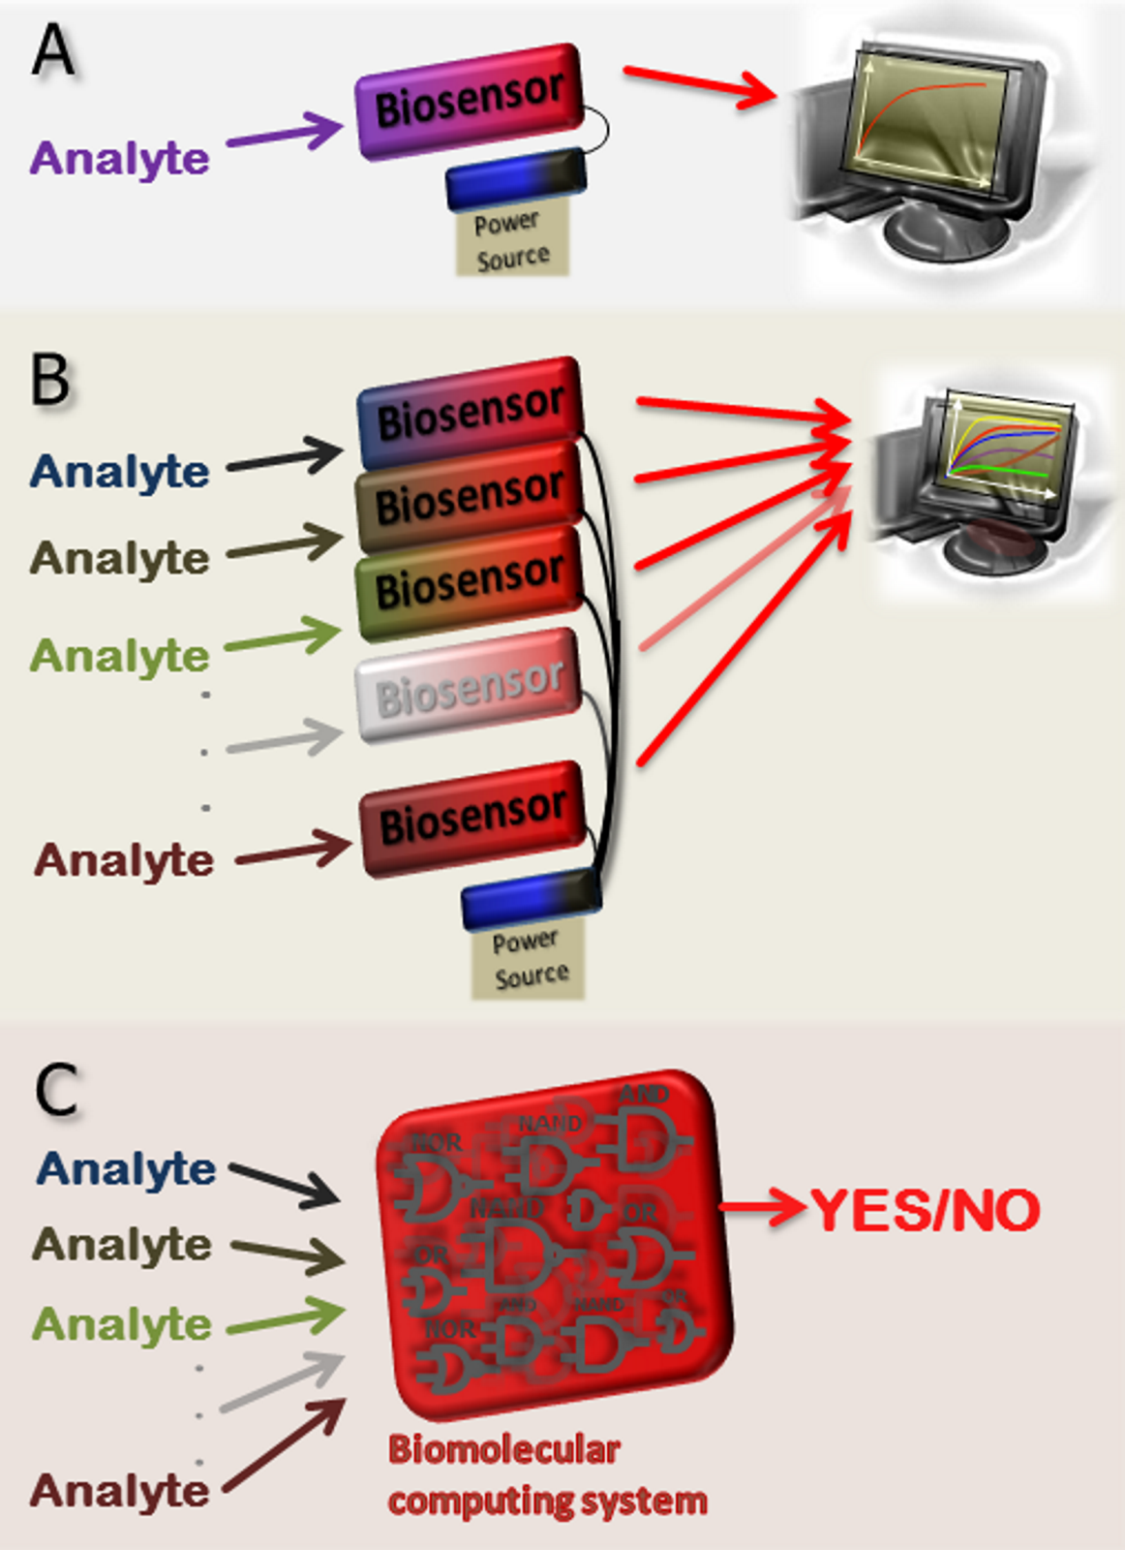
Single analyte biosensor
Multi analyte biosensor array
Multi analyte biosensor with biomolecular logic processing of input signals
E. Katz, J. Wang, M. Privman, J. Halámek
Anal. Chem. 2012, 84, 5463-5469.

Slide 11
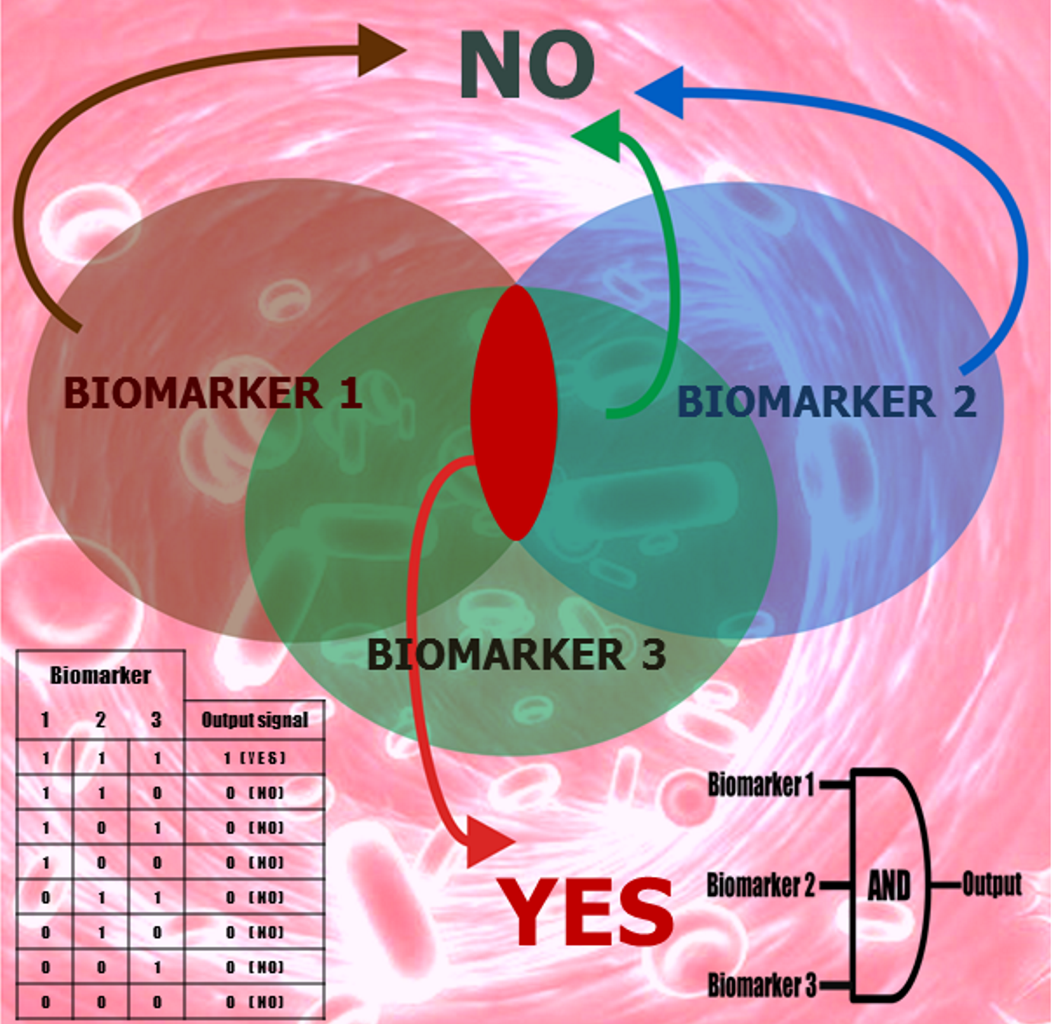
Logic processing of biomarkers with limited specificity

Slide 12
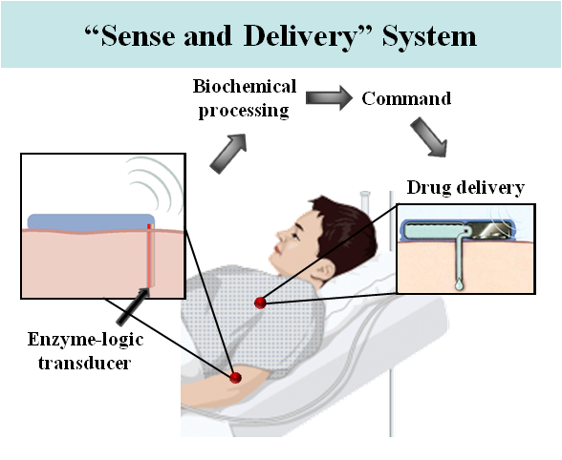
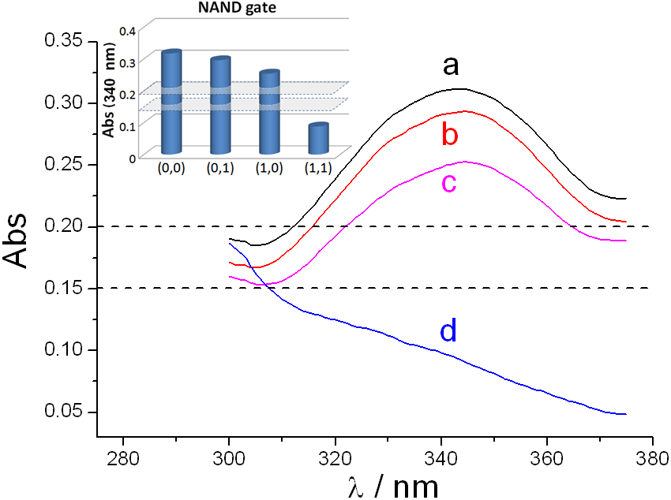
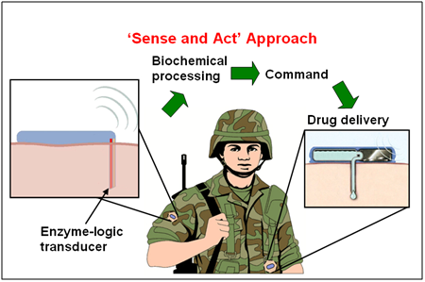
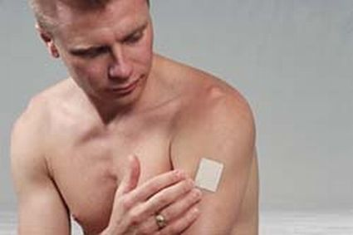
Moving from fundamental research to practical applications – Approaching digital biosensors with information processing via enzyme logic networks
Project supported by the Office of Naval Research
Logic gate
Sensor patch
From science to practical applications

Slide 13
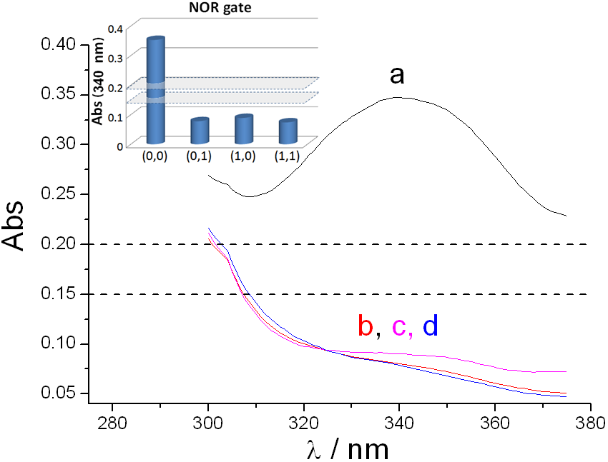
Definition of logic values
Regular studies on chemical (enzyme) logic systems allow arbitrary definitions of logic inputs (putting logic “0” at physical zero value), thus providing large difference in “0” and “1” outputs.
Biomedical systems require specific definitions of “0” and “1” logic levels for the input signals
Physiological condition
Healthy individual
Logic “0” : Normal levels
Glutathione Red: 556 U/L
Small relative difference !!!
Pathological condition
Injured individual
Logic “1” : Elevated levels
Glutathione Red: 650 U/L
This could result in a small difference between “0” and “1” output values requiring optimization of the logic systems.

Slide 14
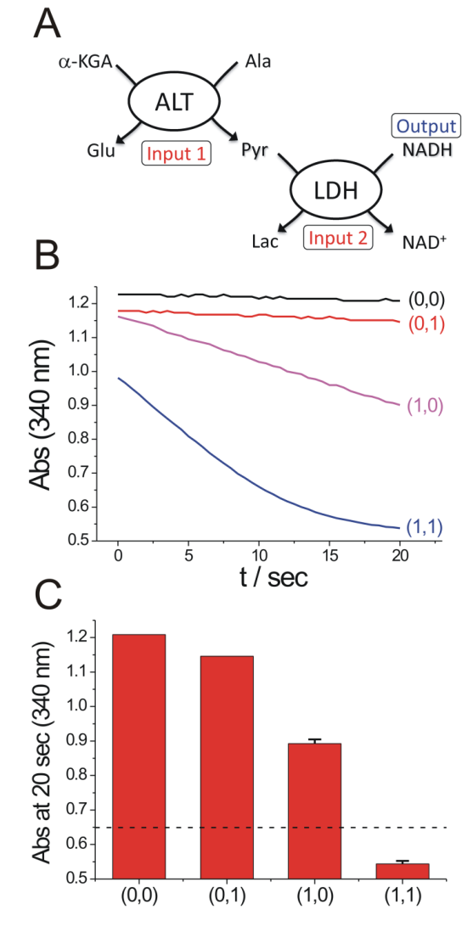
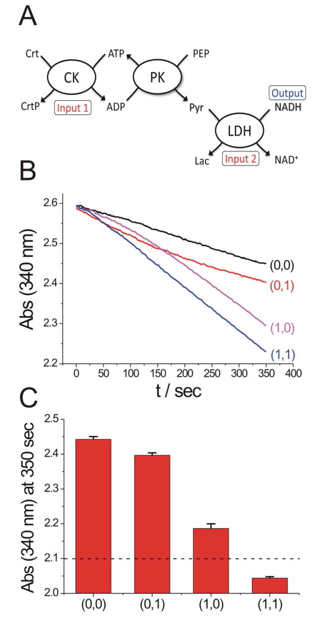
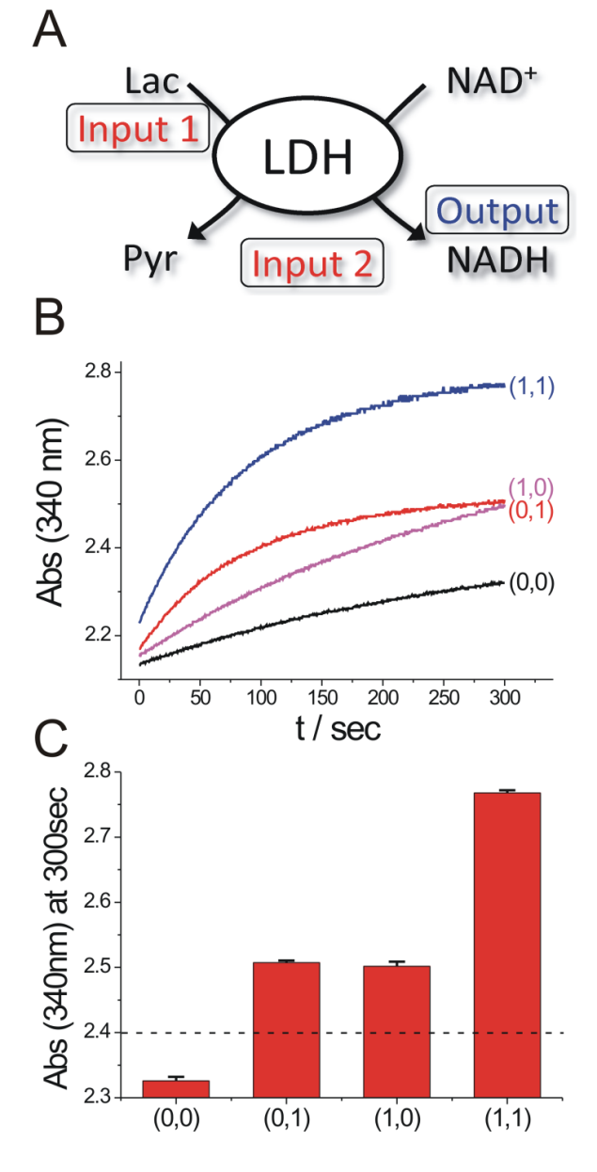
Assessment of pathological conditions upon logic processing various biomarkers
Liver injury
Soft tissue injury
Abdominal trauma
Small difference between the signals requires a “filter” to improve the signal-separation.
Analysis was performed in human serum solutions in the presence of numerous interferants
J. Zhou, J. Halámek, V. Bocharova, J. Wang, E. Katz, Talanta 2011, 83, 955-959.

Slide 15
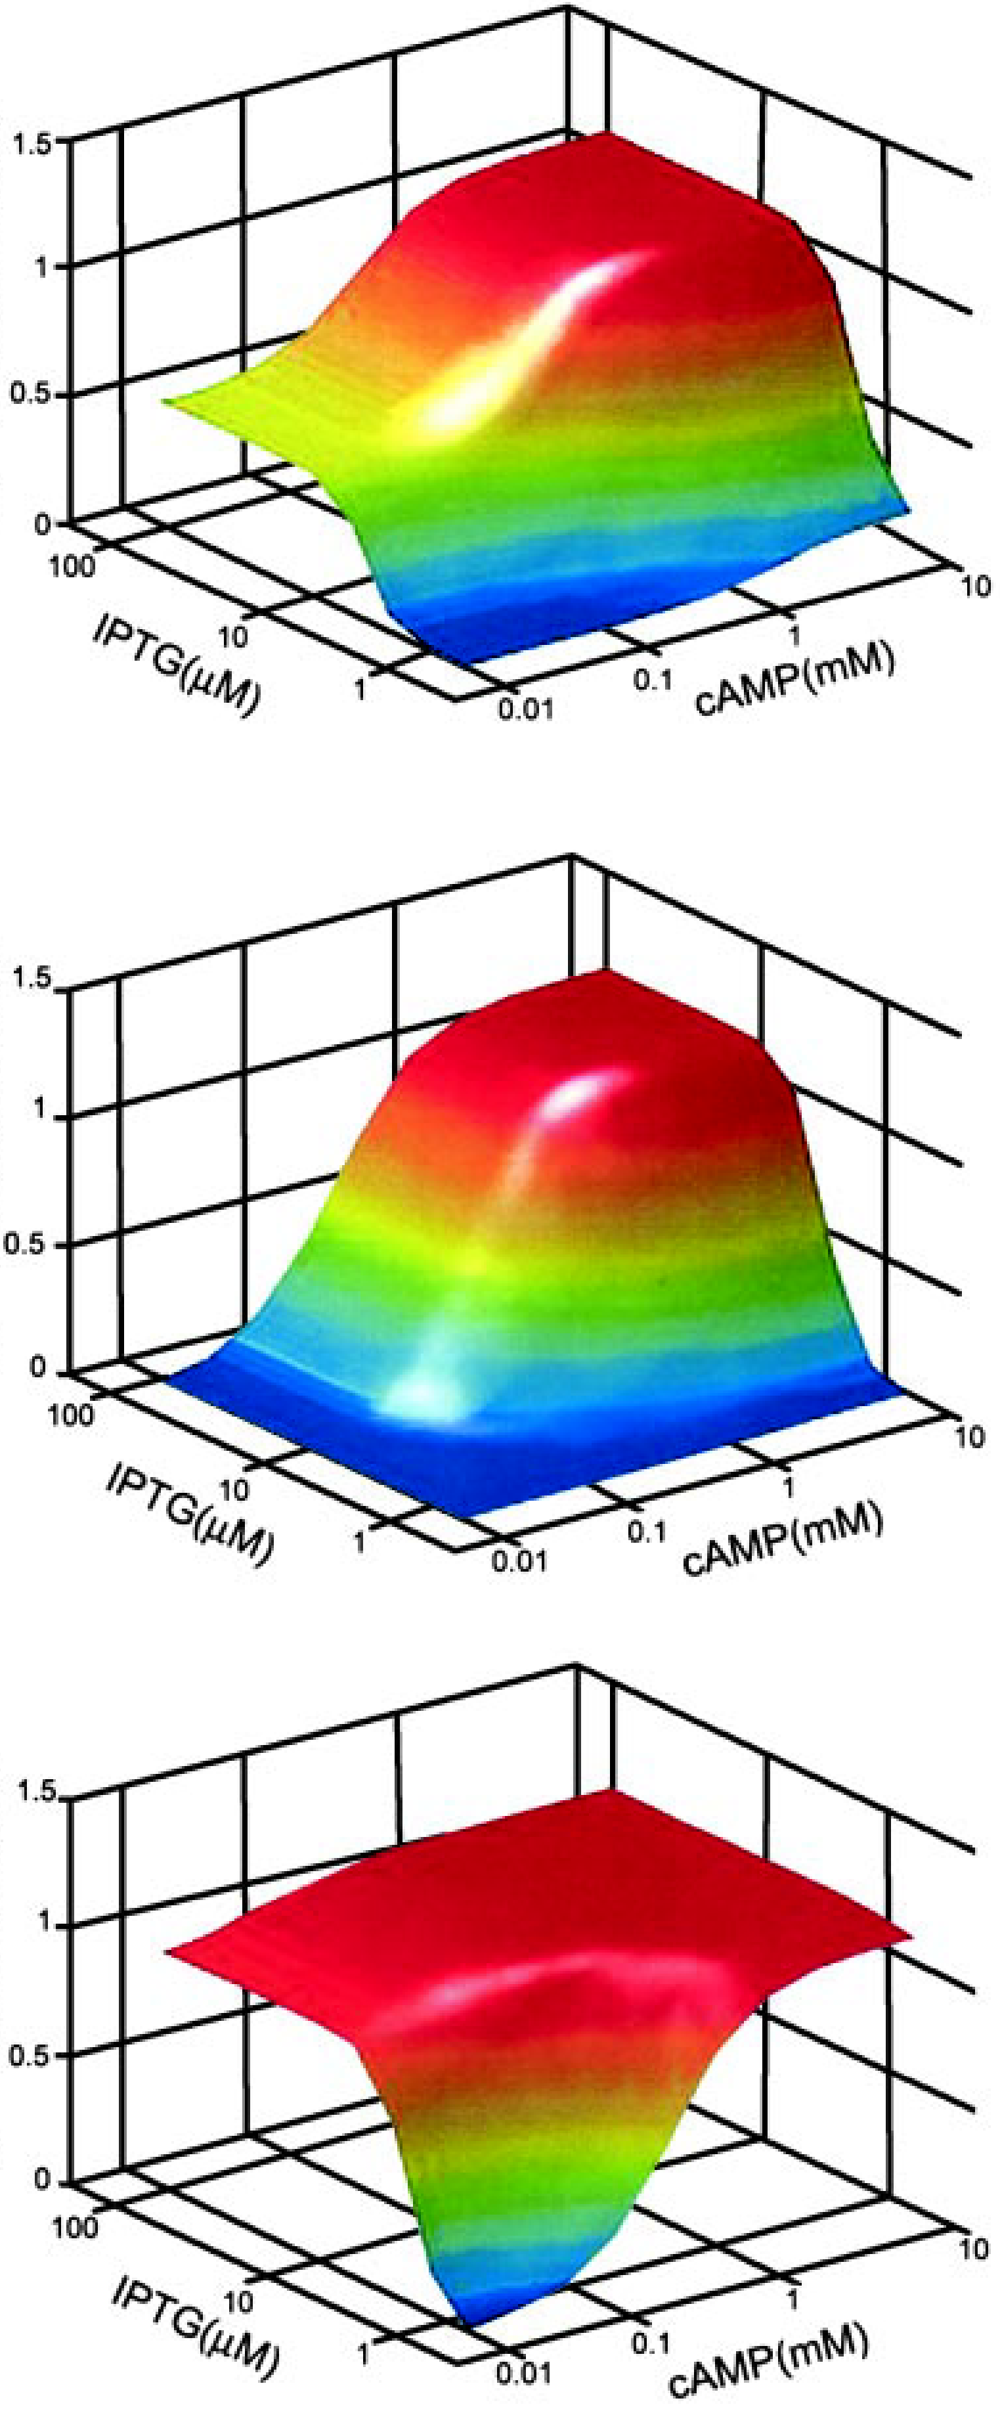
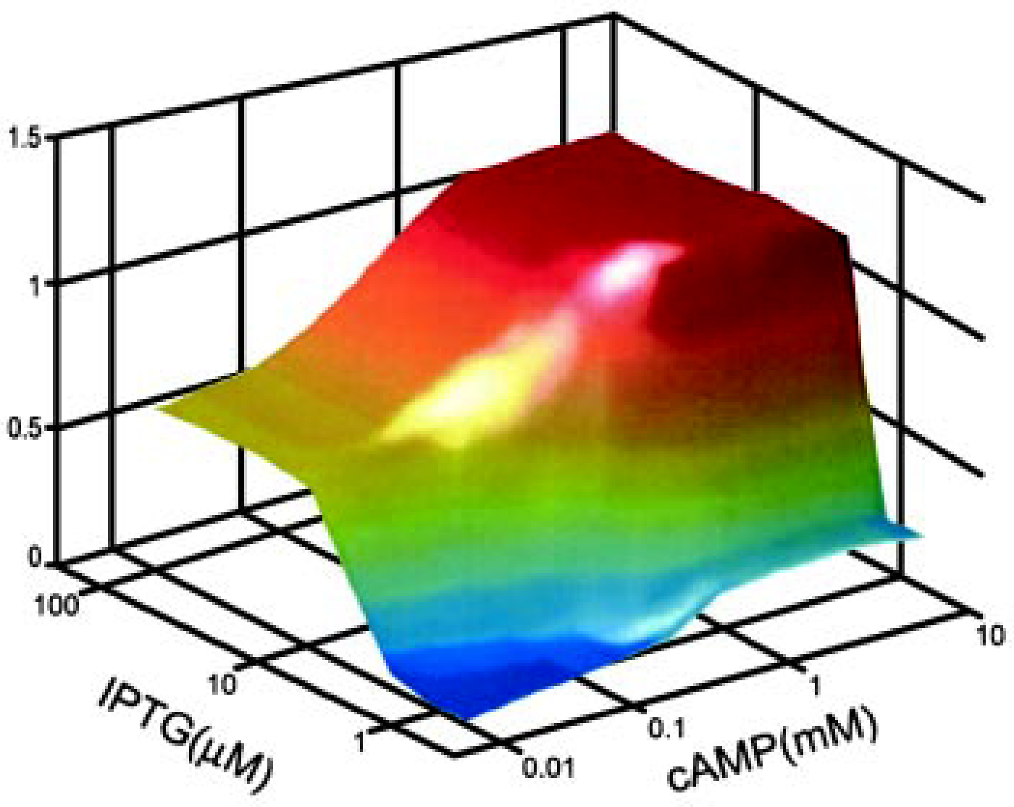
What does Nature do?
Images from: Y. Setty, A. E. Mayo, M. G. Surette, U. Alon, Detailed map of a cis-regulatory input function, PNAS 100, 7702-7707 (2003)

Slide 16
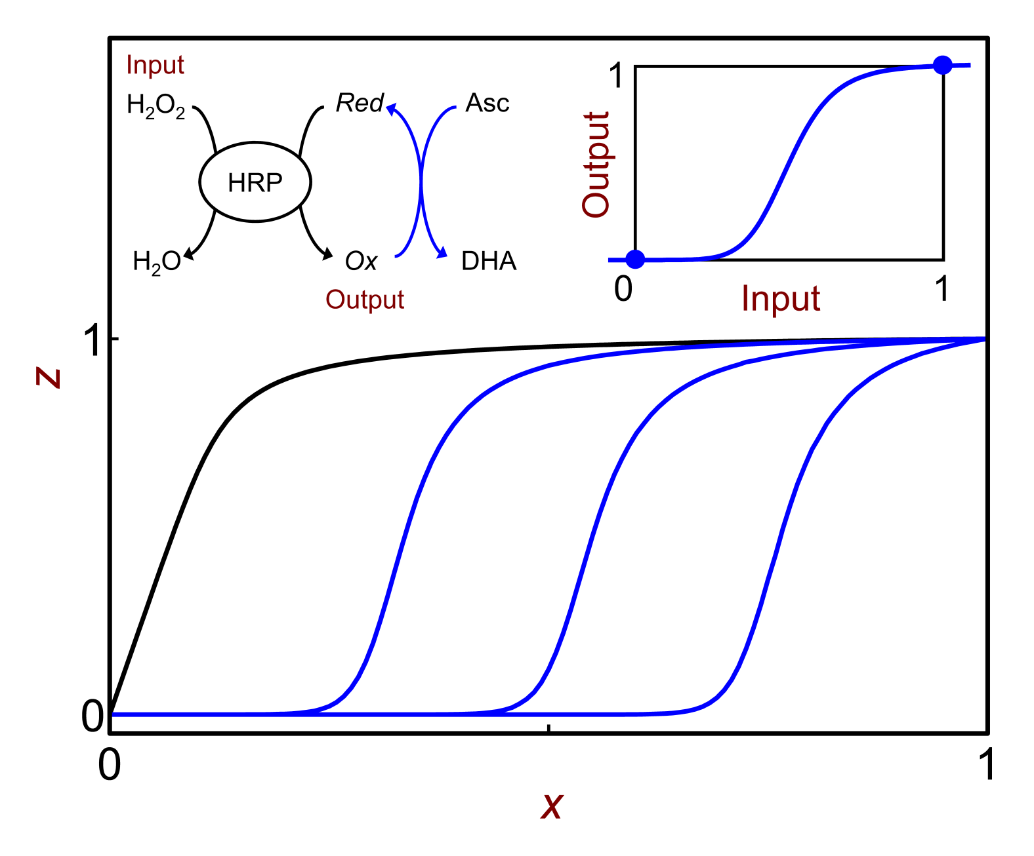
Transition from convex to sigmoidal signal-response in biochemical reactions using a filter system
Perfect shape
convex
sigmoidal
Without filter
Shifting with increasing filter
V. Privman, J. Halámek, M.A. Arugula, D. Melnikov, V. Bocharova, E. Katz, J. Phys. Chem. B 2010, 114, 14103-14109.

Slide 17
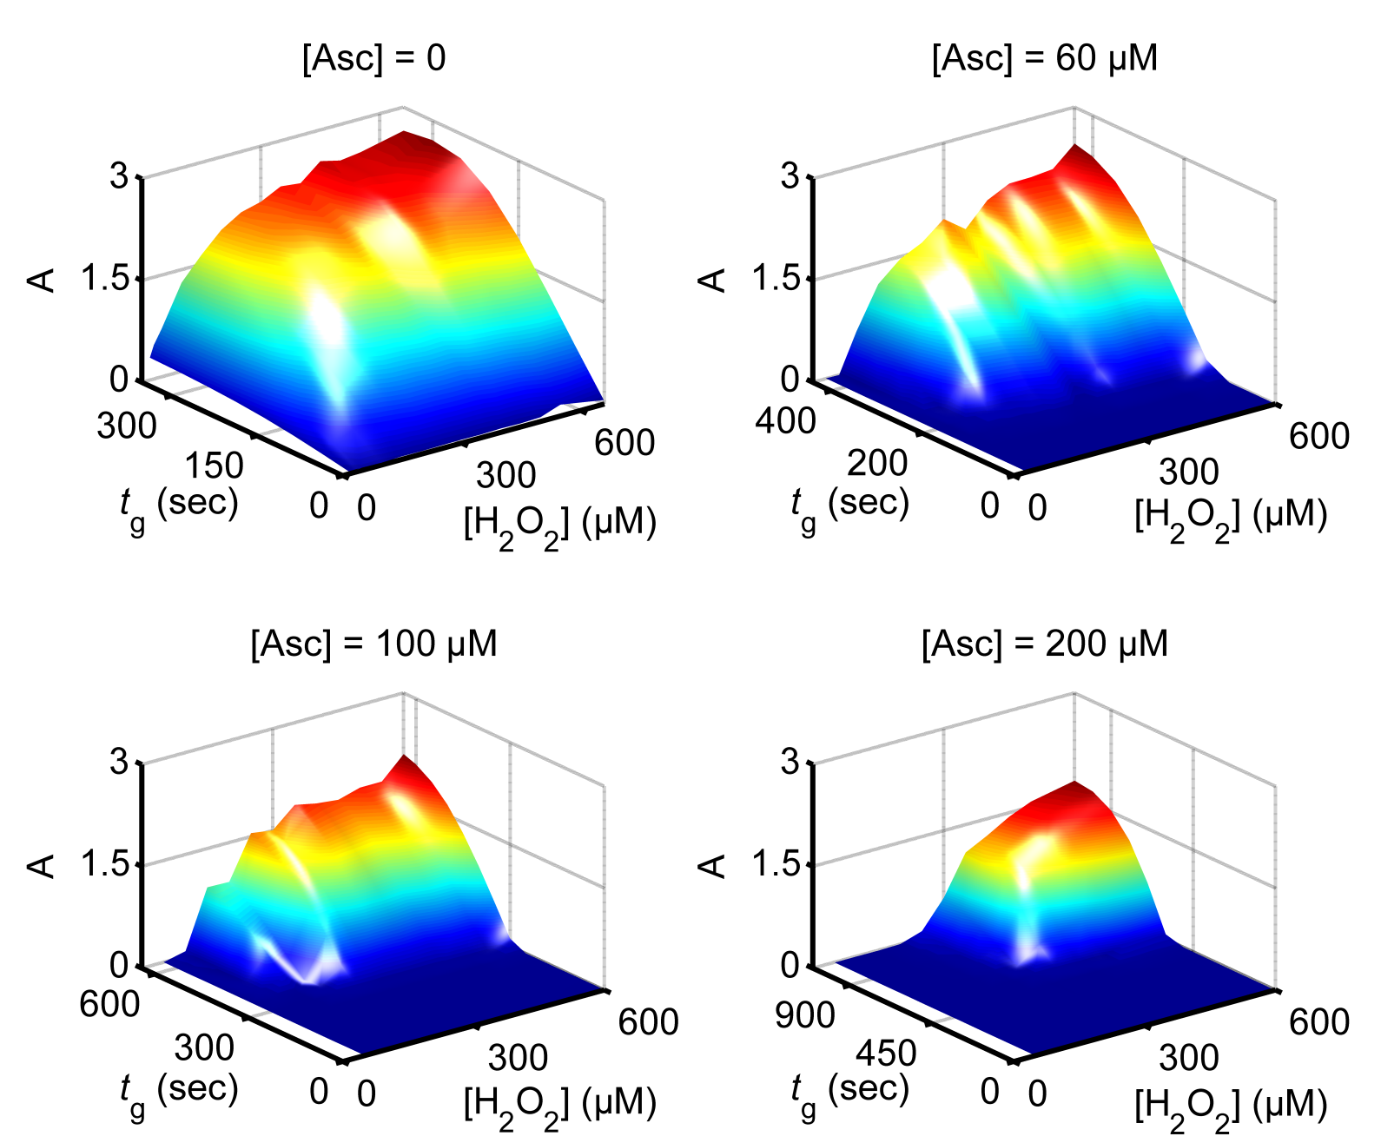
Experimental results with different concentrations of the filtering substrate
(Asc = ascorbate)
V. Privman, J. Halámek, M.A. Arugula, D. Melnikov, V. Bocharova, E. Katz, J. Phys. Chem. B 2010, 114, 14103-14109.

Slide 18
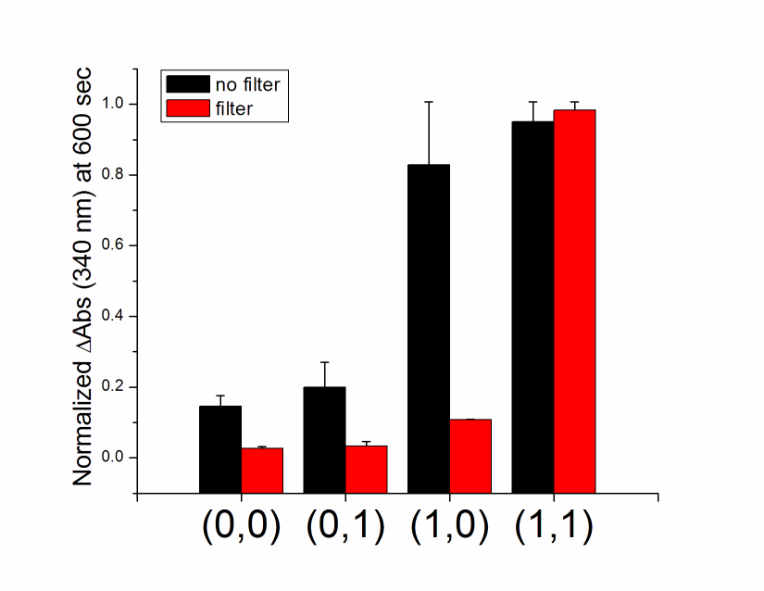
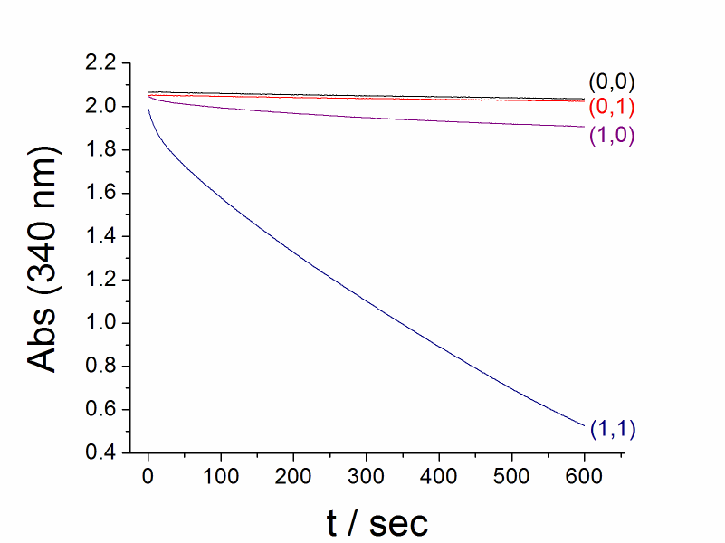
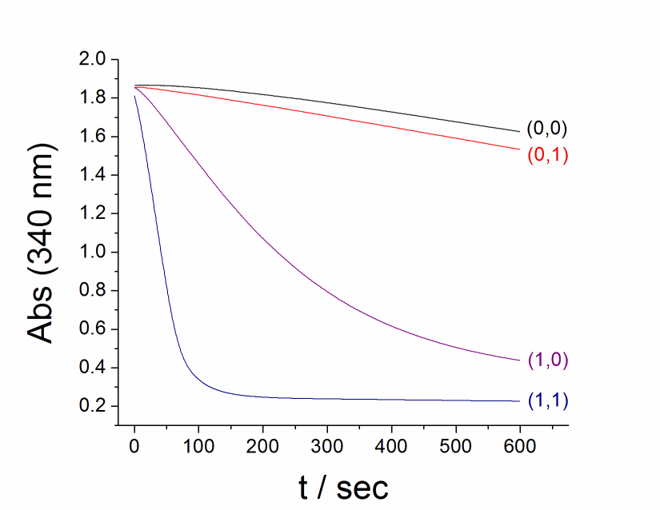
Analysis of biomarkers for liver injury – effect of biochemical filter system
Lac
Glu
Ala
NADH
Glc6P
ALT
LDH
Output
G6PDH
2-OG
Input 1
Pyr
Input 2
NAD⁺
6-PGluc
J. Halámek, J. Zhou, L. Halámková, V. Bocharova, V. Privman, J. Wang, E. Katz, Anal. Chem. 2011, 83, 8383-8386.

Slide 19
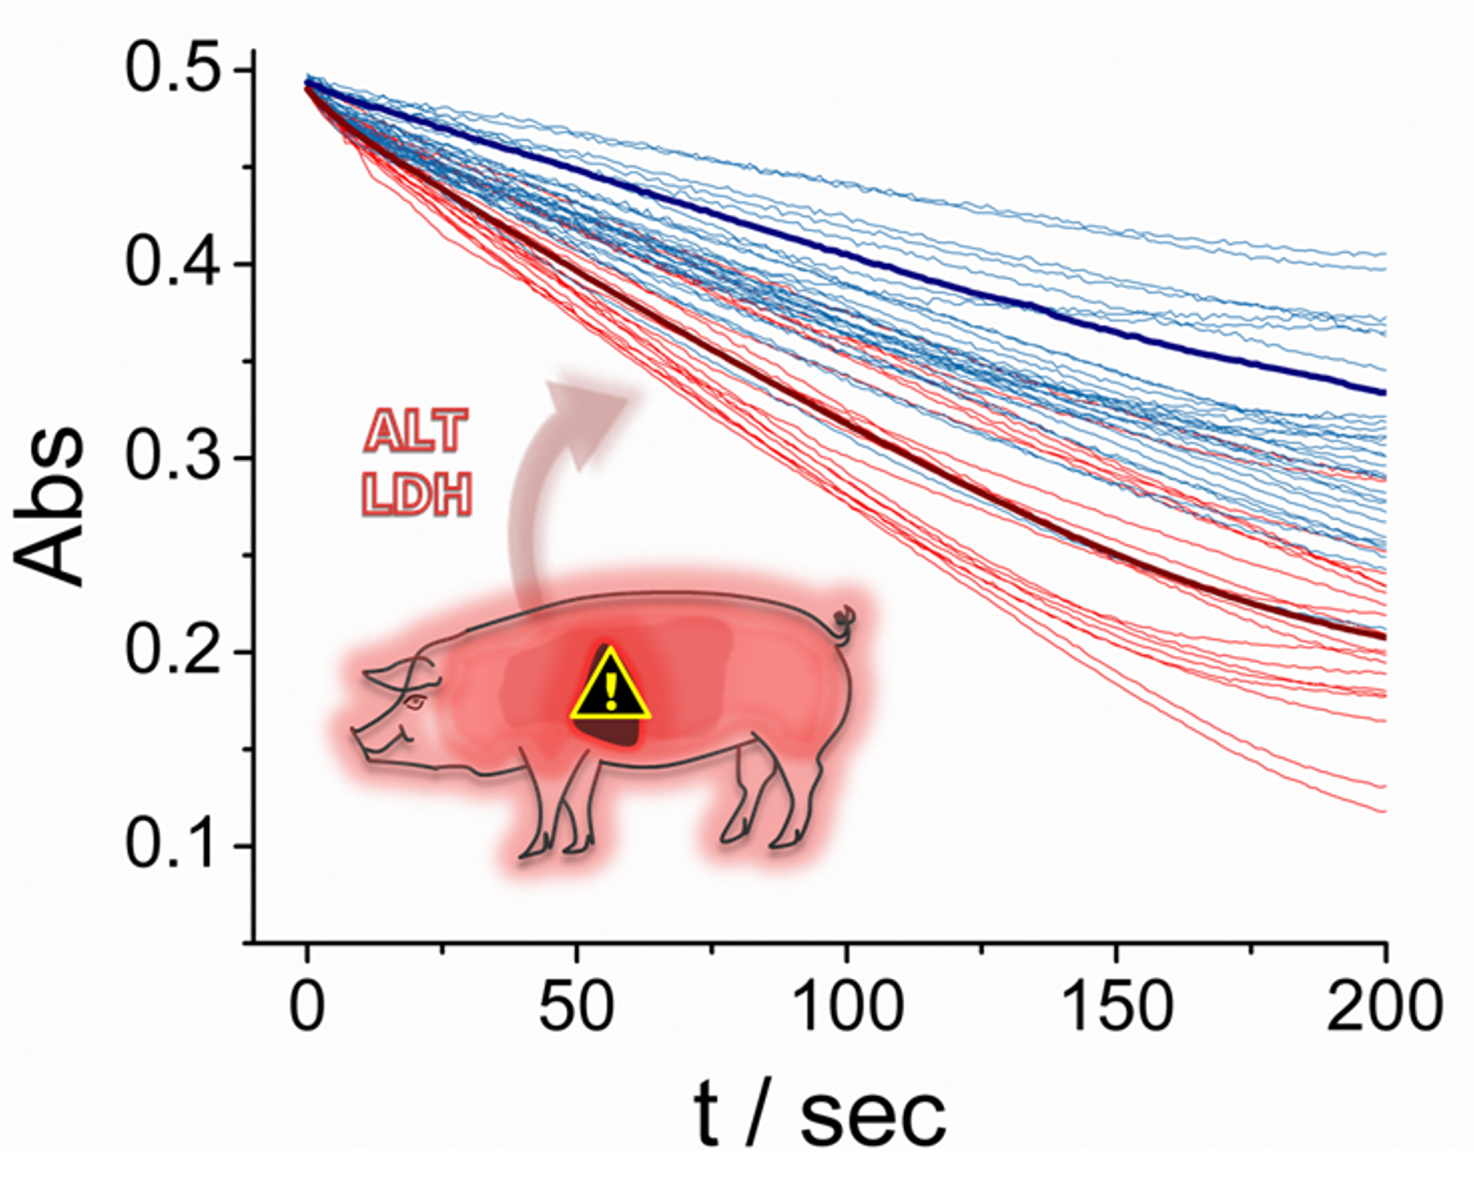
Real animal model – analysis of liver injury biomarkers in porcine samples
L. Halámková, J. Halámek, V. Bocharova, S. Wolf, K.E. Mulier, G. Beilman, J. Wang, E. Katz, Analyst 2012, 137, 1768-1770.

Slide 20
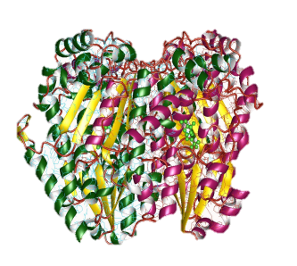
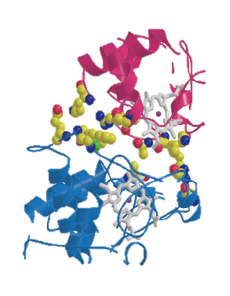
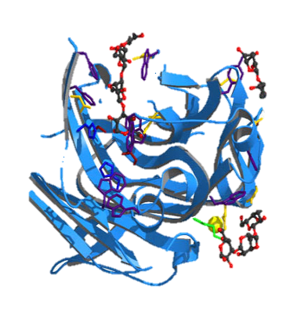
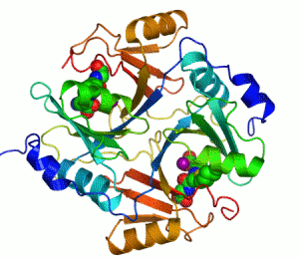
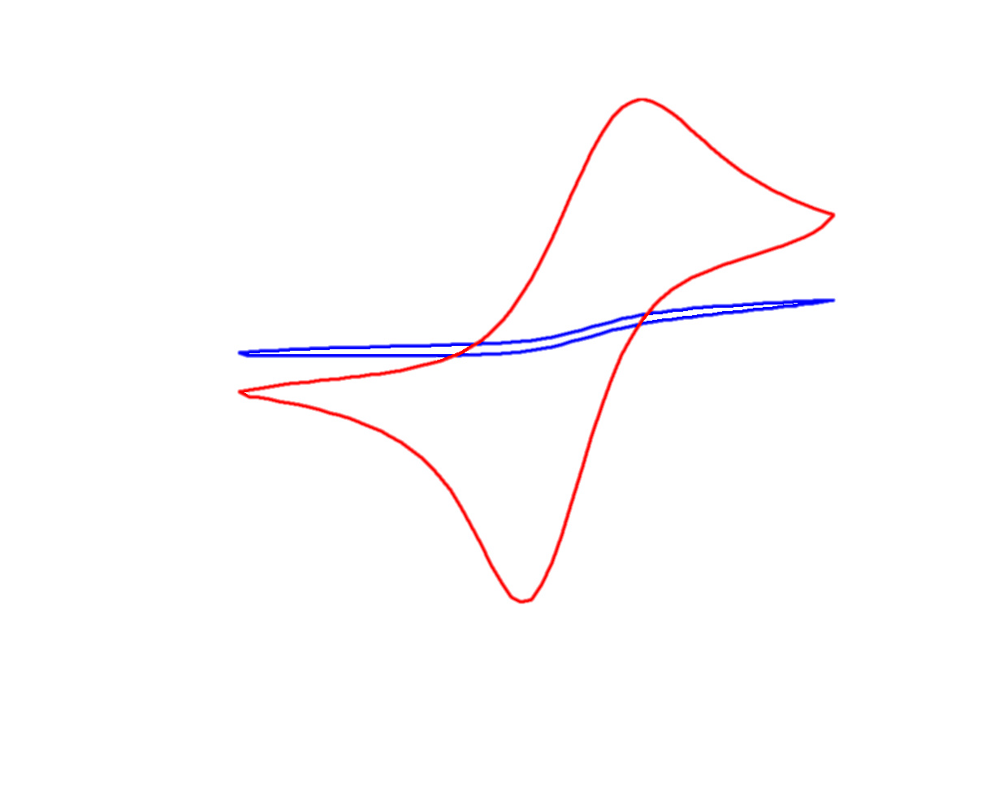
Digital analytical output can be used to switch ON/OFF signal-responsive materials resulting in chemical actuation (e.g. drug release triggered by a combination of biomarkers).
0
1
0
1
0
1
0
1
0
1
1
1
1
0
0
1
1
Digital Logic
ON
OFF

Slide 21
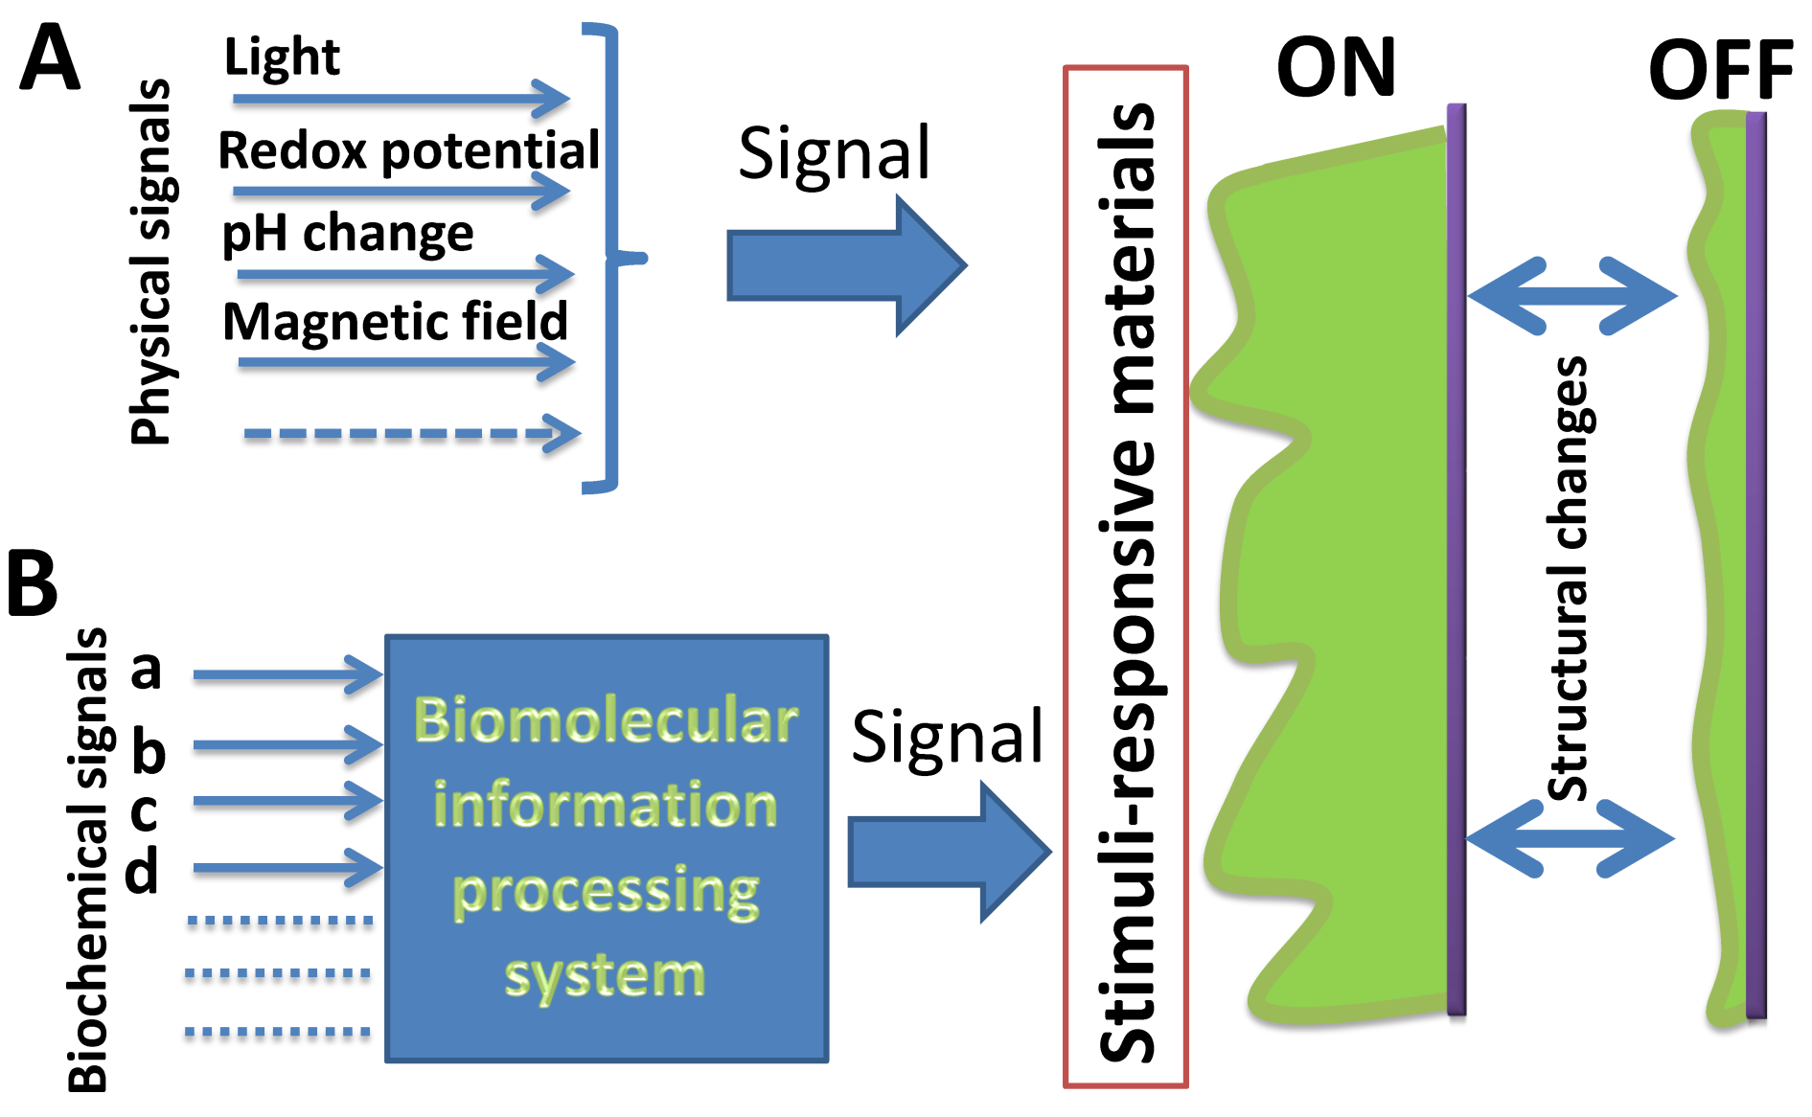
Signal-responsive materials activated by single input signals (A) and by multiple inputs logically processed by a biomolecular computing system (B).
E. Katz, V. Bocharova, M. Privman, J. Mater. Chem. 2012, 22, 8171-8178.

Slide 22
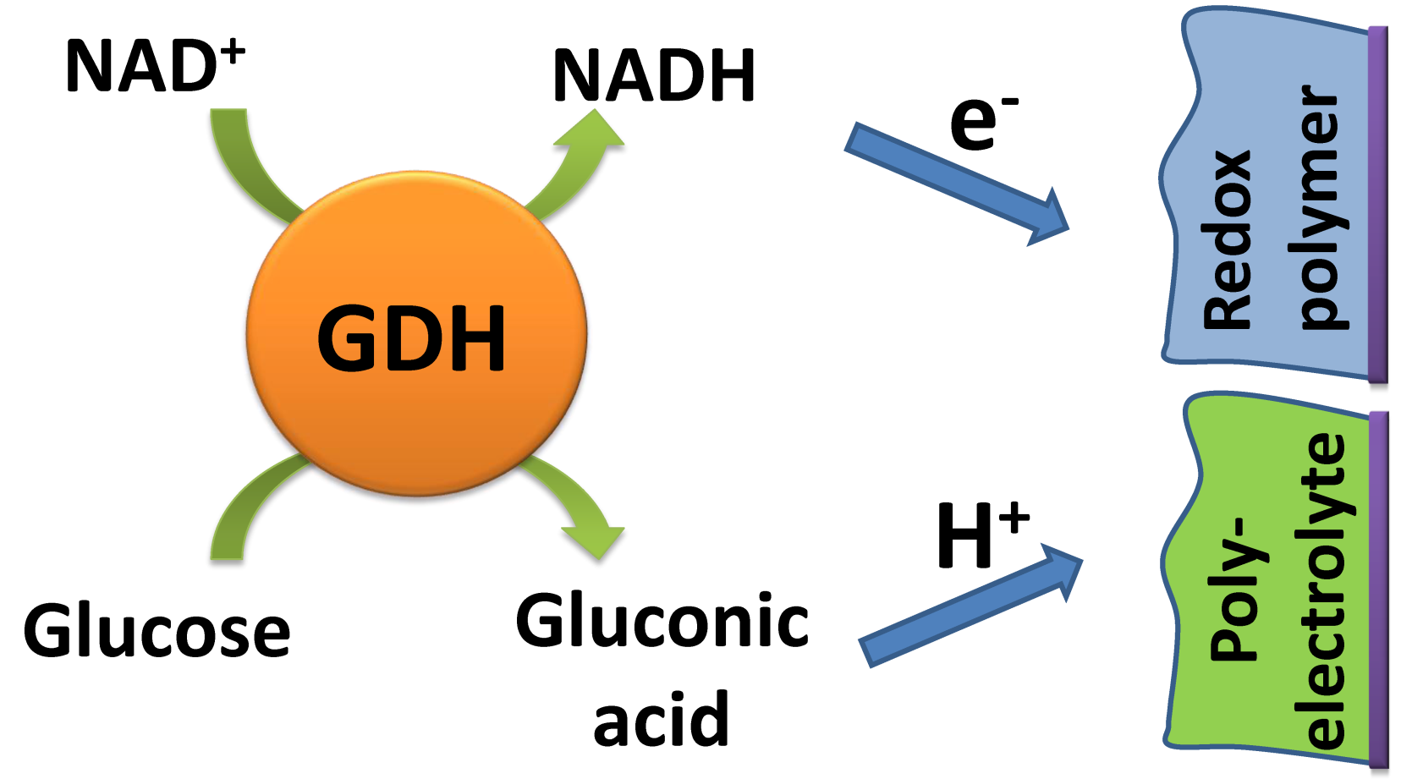
Enzymatically produced redox species and pH changes coupled to signal-responsive redox polymers and polyelectrolytes
Enzyme – glucose dehydrogenase
E. Katz, V. Bocharova, M. Privman, J. Mater. Chem. 2012, 22, 8171-8178.

Slide 23
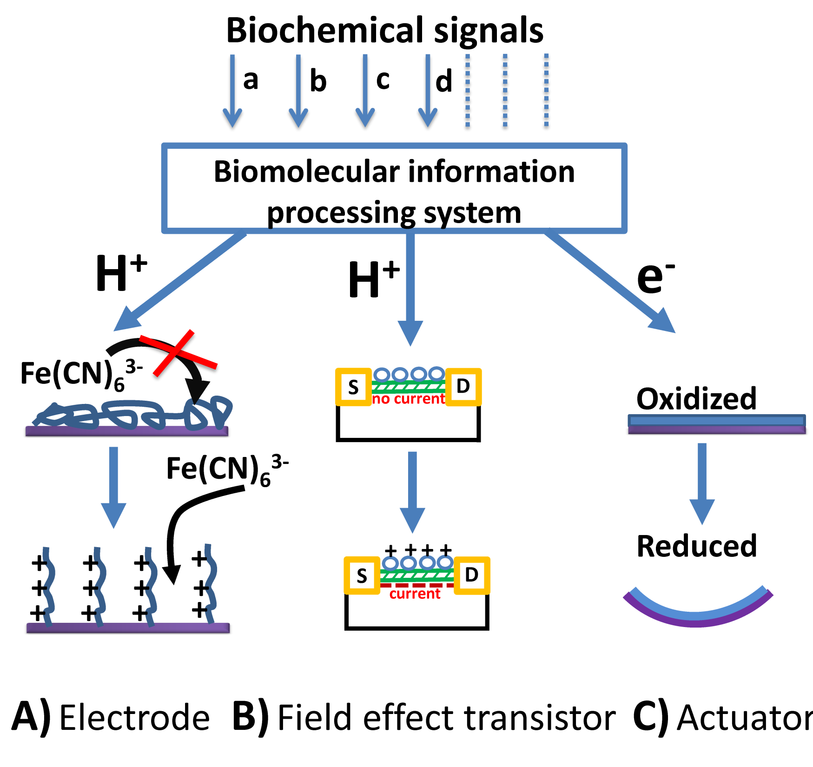
Biocomputing systems functionally integrated with electrodes, Si-chips and chemical actuators
Exemplified in the next slide
E. Katz, V. Bocharova, M. Privman, J. Mater. Chem. 2012, 22, 8171-8178.

Slide 24
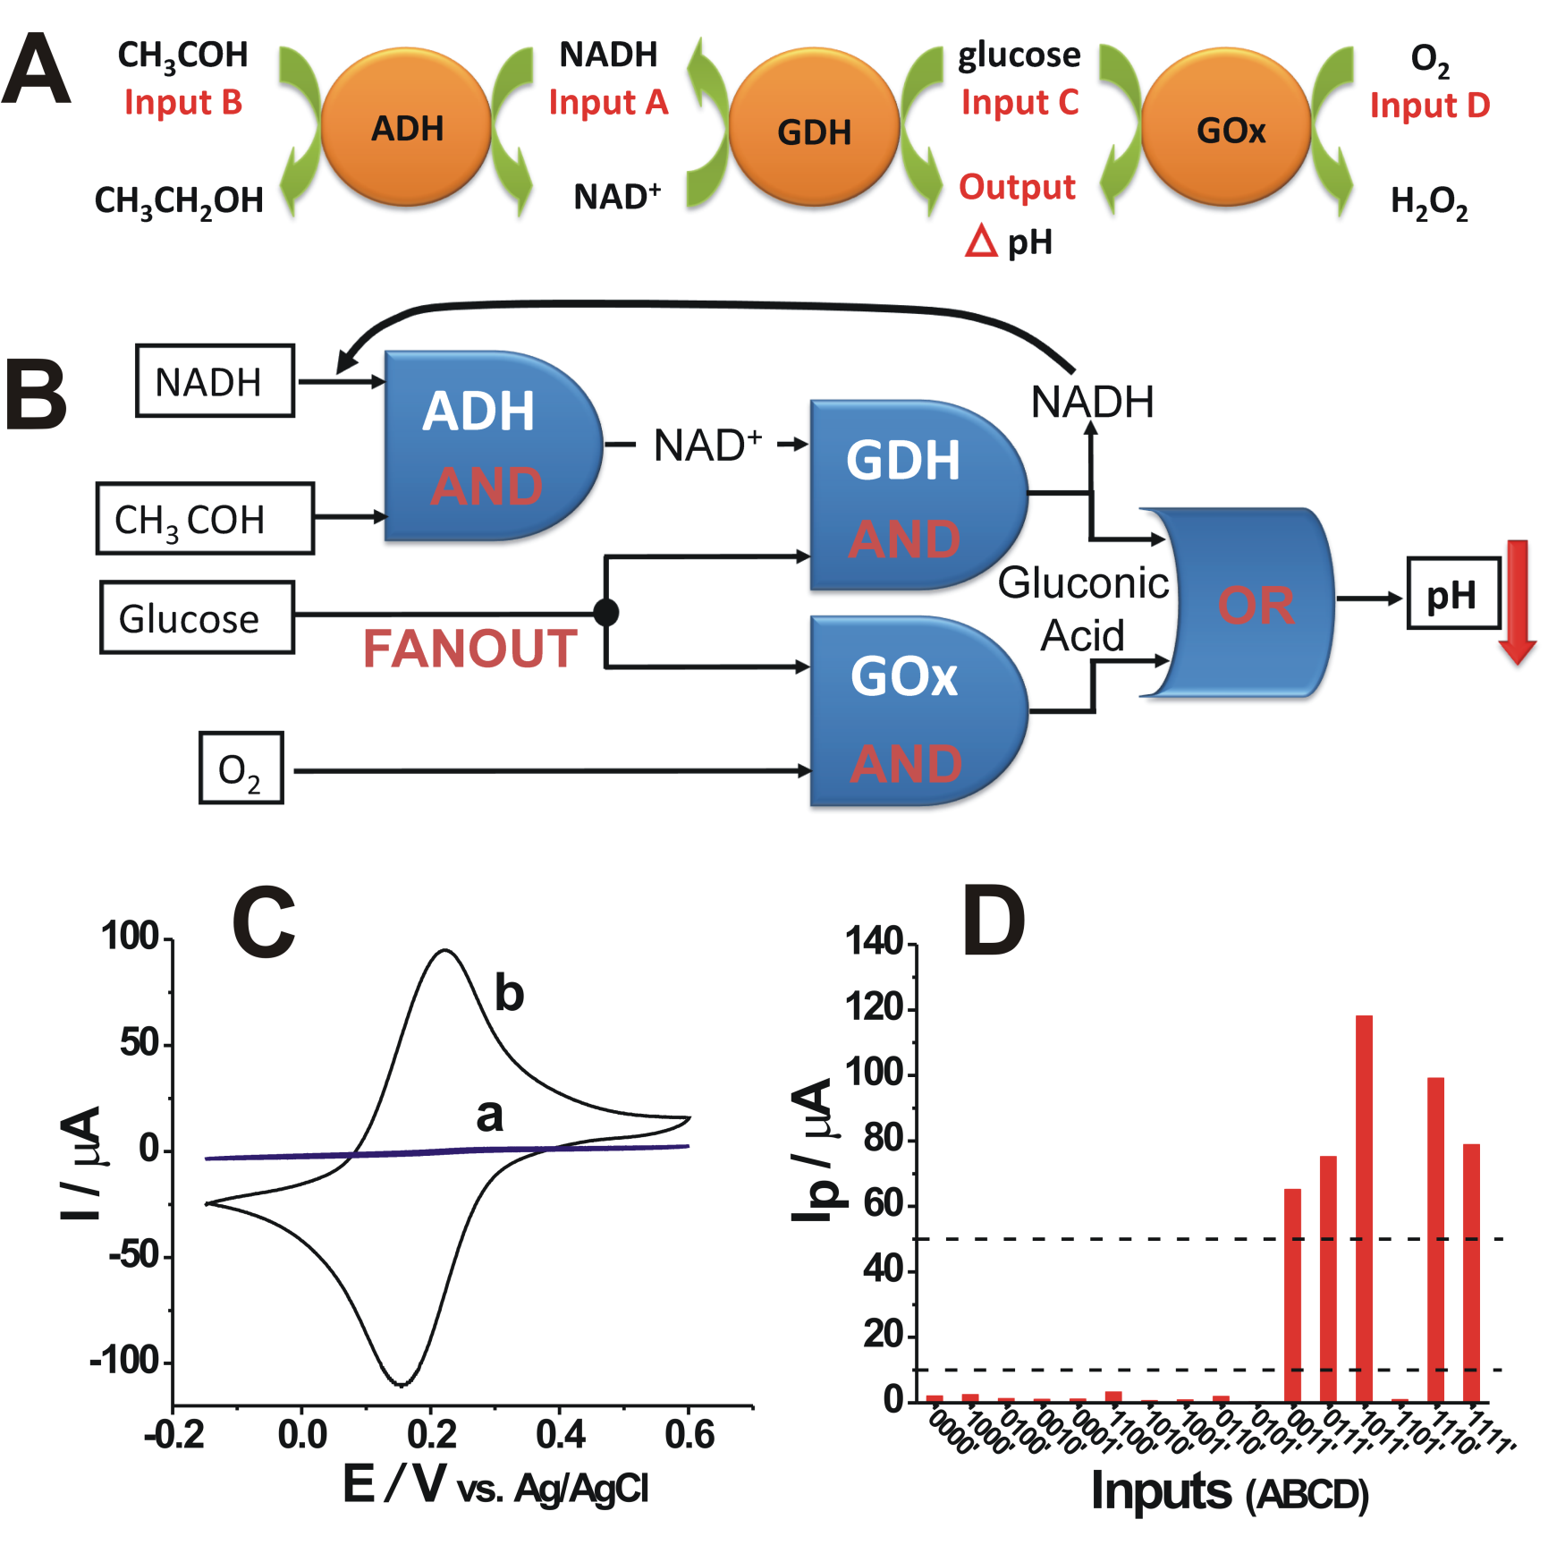
Switchable electrode controlled by biochemical signals logically processed by a biocomputing system
M. Privman, T.K. Tam, M. Pita, E. Katz, J. Am. Chem. Soc. 2009, 131, 1314-1321.

Slide 25
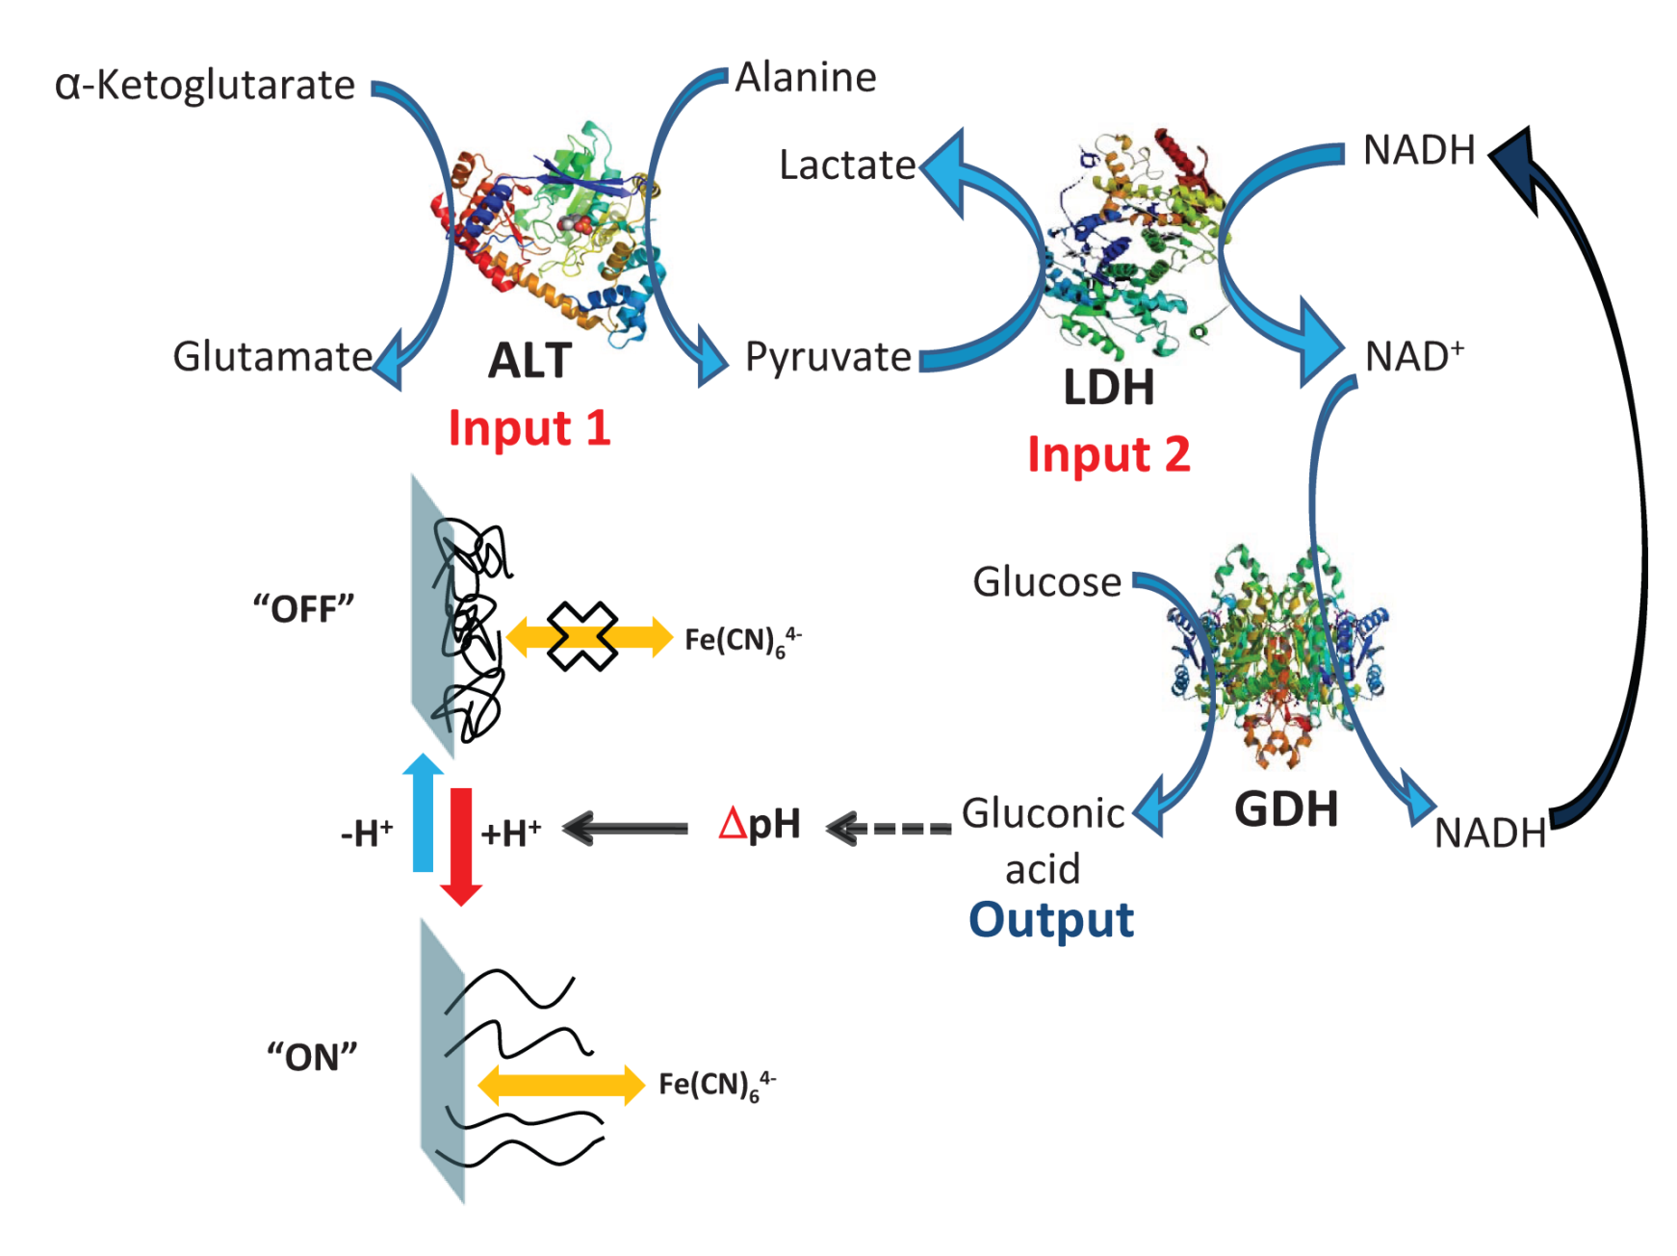
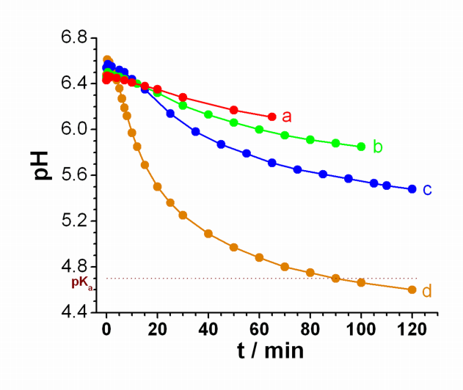
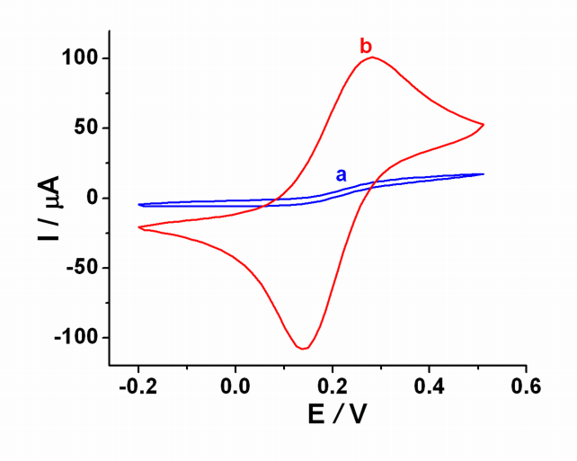
Electrode activation by liver injury biomarkers
M. Privman, T.K. Tam, V. Bocharova, J. Halámek, J. Wang, E. Katz, ACS Appl. Mater. Interfaces 2011, 3, 1620-1623.

Slide 26
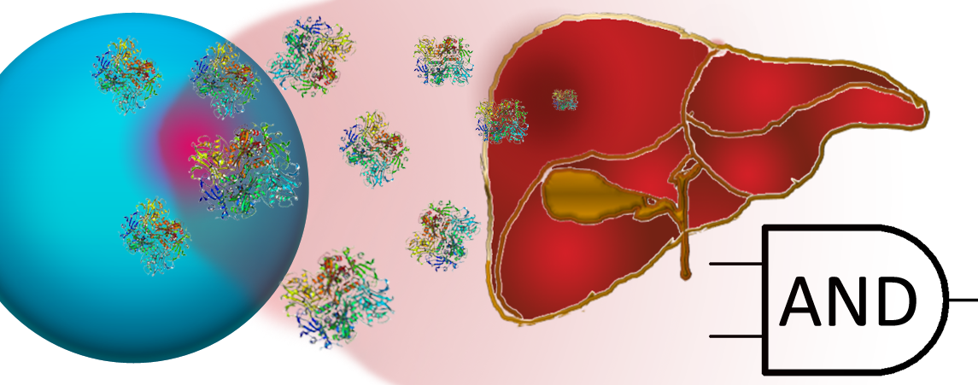
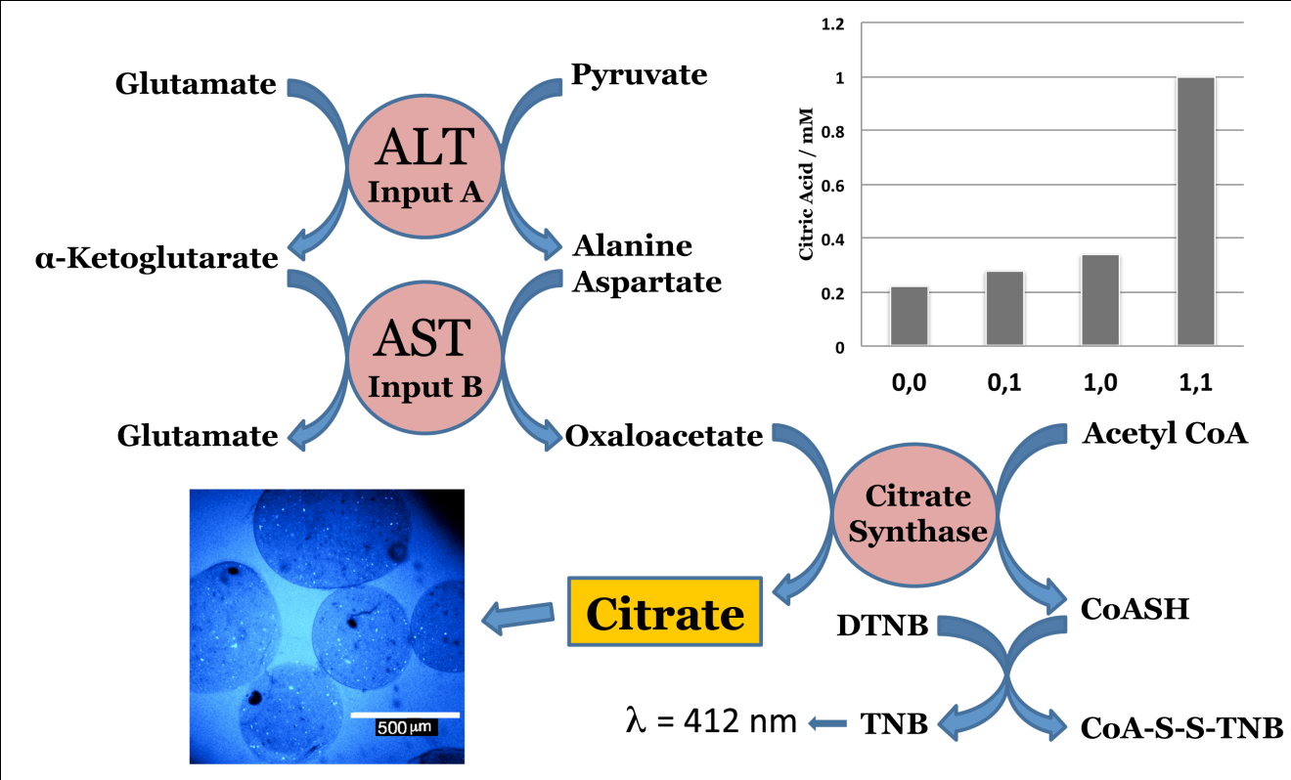
Drug release stimulated by liver injury biomarkers operating as AND gate
V. Bocharova, O. Zavalov, K. MacVittie, M,A. Arugula, N.V. Guz, M.E. Dokukin, J. Halámek, I. Sokolov, V. Privman, E. Katz, J. Mater. Chem. 2012, 22, 19709-19717.

Slide 27
Only simultaneous increase of concentrations of both biomarkers results in the microsphere dissolution and drug release
V. Bocharova, O. Zavalov, K. MacVittie, M,A. Arugula, N.V. Guz, M.E. Dokukin, J. Halámek, I. Sokolov, V. Privman, E. Katz, J. Mater. Chem. 2012, 22, 19709-19717.

Slide 28
Scientific activities overviewed in the lecture:
Biocomputing (biomolecular computing): Enzyme-logic gates and their networks.
Biosensors and bioactuators – Multi-signal chemical devices integrated with biocomputing systems.
Biofuel cells – "Smart" biofuel cells controlled by biochemical signals and implantable biofuel cells.

Slide 29
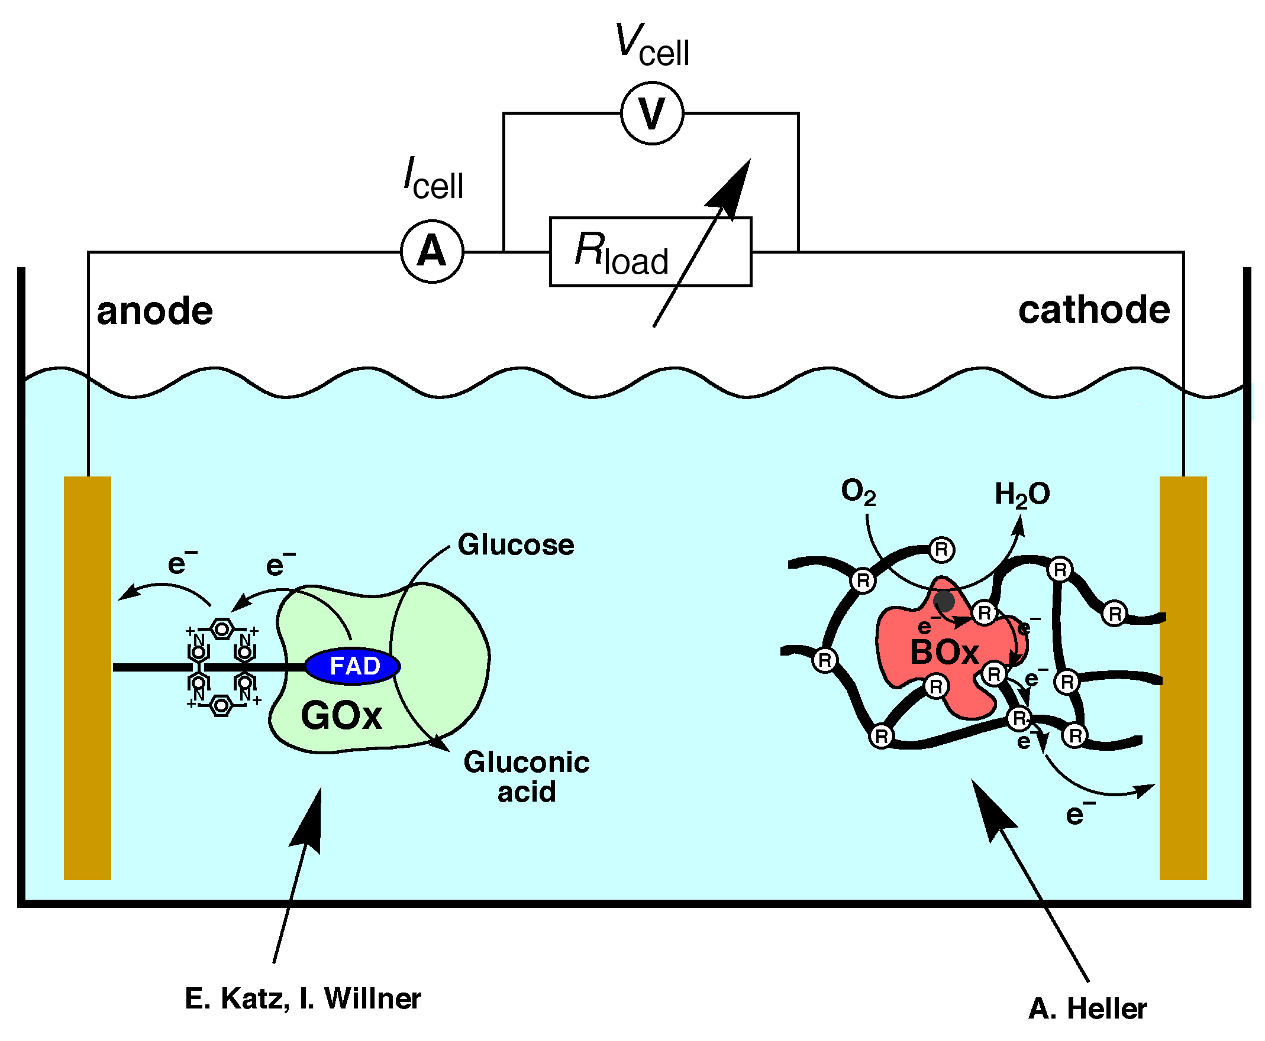
Biofuel Cells
Anode example
Cathode example

Slide 30
Biofuel cell controlled by enzyme logic network – Approaching physiologically regulated devices
pH changes
Multi-enzyme system logically processing multiple biochemical signals
Power output
T.K. Tam, M. Pita, M. Ornatska, E. Katz,
Bioelectrochemistry 2009, 76, 4-9.

Slide 31
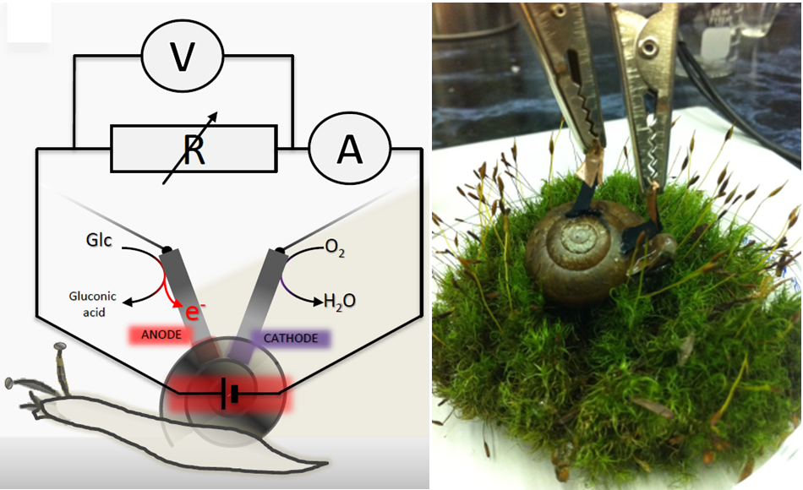
Biofuel cell implanted in snail for in vivo operation
L. Halámková, J. Halámek, V. Bocharova, A. Szczupak, L. Alfonta, E. Katz, J. Am. Chem. Soc. 2012, 134, 5040-5043.

Slide 32
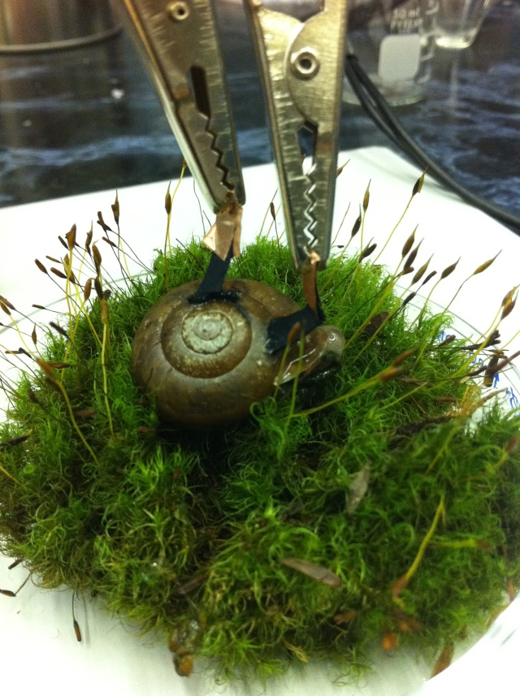
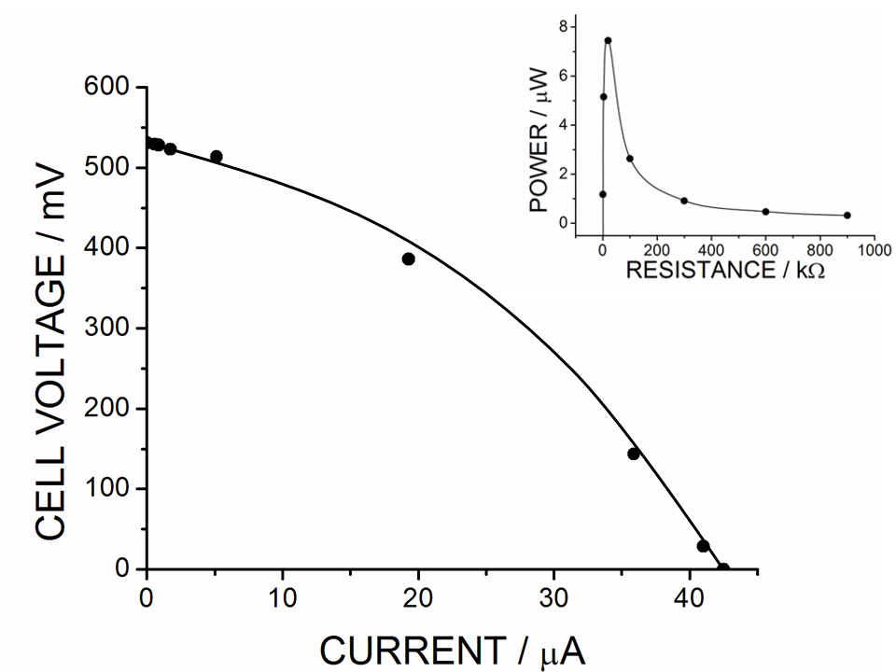
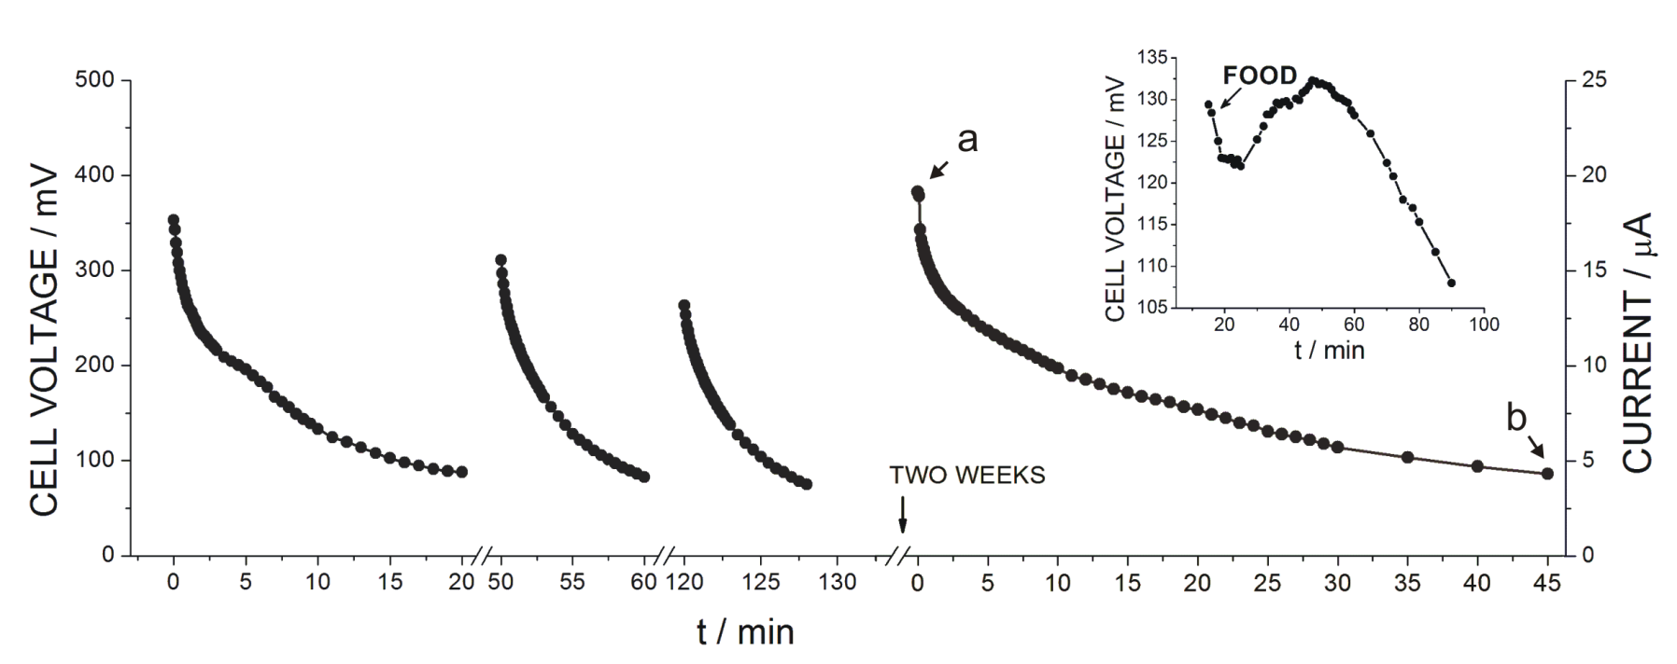

Slide 33
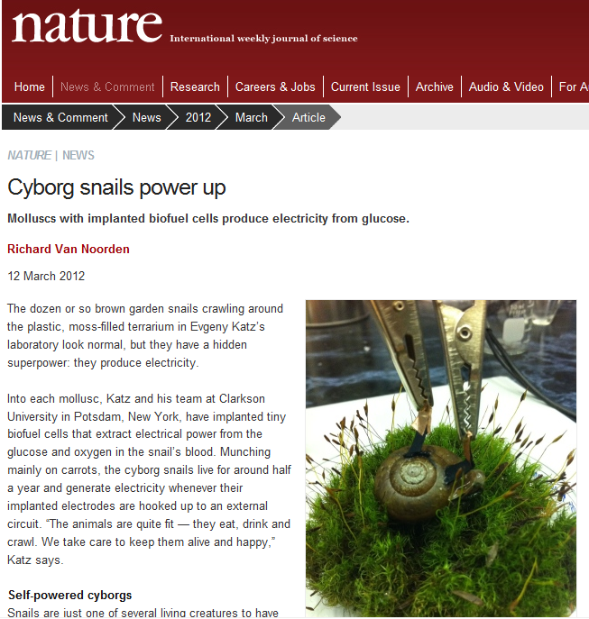

Slide 34
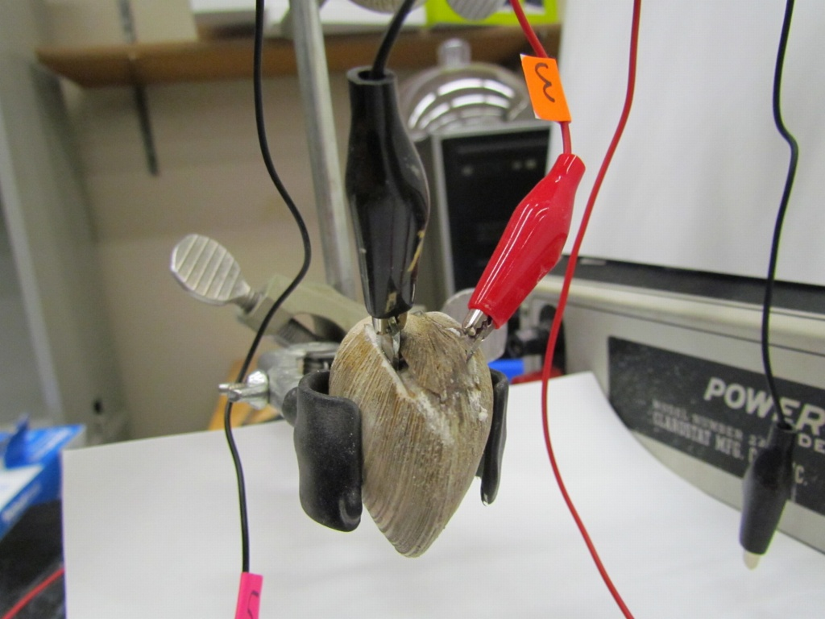
Biofuel cell implanted in clam for in vivo operation
A. Szczupak, J. Halámek, L. Halámková, V. Bocharova, L. Alfonta, E. Katz,
Energy & Environmental Science 2012, in press (DOI: 10.1039/C2EE21626D).

Slide 35
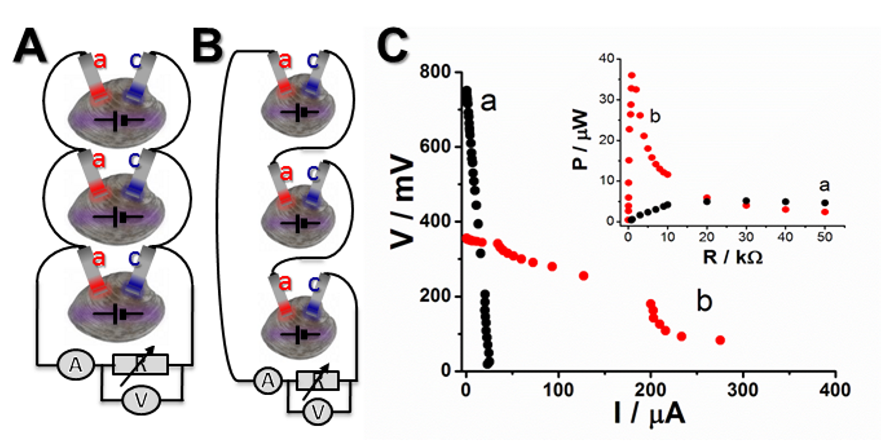
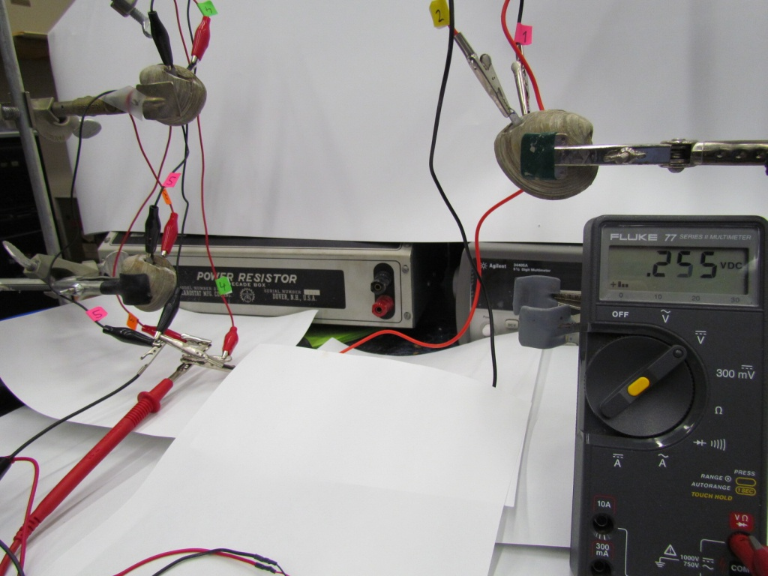

Slide 36

Getting electrical power for activating electronic devices: From the animal research to biomedical applications

Slide 37

Activation of a digital watch (as a model device) by the implanted biofuel cells

Slide 38

Activation of a pacemaker by the implantable biofuel cells mimicking human physiology

Slide 39


Bioelectrocatalytic electrodes operating in vivo can be used for many different bioelectronic and biosensor applications
Fuel
Power from biofuel cell
O
Electrode
C
NH
Information from biosensor
Analyte

Slide 40
Conclusions
Biochemical computing can be used for coupling of biochemical systems with electronic interfaces.
Novel multi-signal biosensors can be designed based on the enzyme logic systems. Biomedical applications of enzyme logic system are feasible.
Coupling of biocomputing systems with signal responsive materials offers a new approach to “smart” materials and multi-signal responsive biosensors and “smart” biofuel cells.
“Smart”-signal controlled biofuel cells were designed.
Implantable biofuel cells operating in vivo were developed.

Slide 41



The research is supported by:

Slide 42

Bioelectronics & Bionanotechnology group of Prof. Evgeny Katz, Clarkson University (January 2011)

Slide 43

Thank you! Any questions?
Evgeny Katz, Dept. of Chemistry & Biomolecular Science, Clarkson University

