Slide 1
Modeling and Statistics in Digital Marketing and Business Strategies
Devin Kapper
Senior Data Analyst, IXIS Digital, LLC.
10 June, 2022

Slide 2
Background
Hometown: Westport
Undergrad: Manhattanville College in Harrison
Master’s: Rensselaer Polytechnic Institute in Troy
Ph.D. and Postdoc: Clarkson University in Potsdam
Job: IXIS Digital, LLC in Burlington, VT
Current Residence: Plattsburgh

Slide 3
Outline
Overview of corporate structure and technical knowledge required
Exploratory data analysis and generation of business questions
Setting up queries for data acquisition
Statistical methodologies and in-depth analyses
Technical coding workflow
Courses and experiences useful for professional development

Slide 4
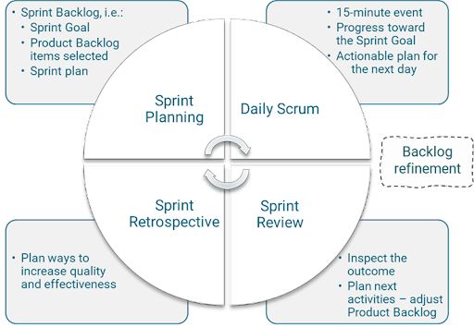
Overview of corporate structure and technical knowledge required
IXIS (Interactive eXperience/Integrated Strategy)
Goal: expand clients’ relationship with their data and help them make data-driven business decisions
Data Analysts/Data Scientists: R (Markdown), SQL, Adobe Analytics (AA), Google Analytics (GA), Python, git, regular expressions (regex)
Workflow uses agile/scrum environment (8 increments of 3 sprints, 4 with a “hip” sprint)
CEO
Client Strategy
Product Management
Engineering
Data Analysts/
Data Scientists
Developers/ Software Eng.
Front/Back End
Engineers
Clients have included: Alex and Ani, Audi, BMW, Bulgari, Chobani, Chrysler, Cole Haan, Eileen Fisher, FTD, Karl Lagerfeld, Kia, Nutrisystem, Samsonite, Temple St. Clair, Tom Ford, Tumi
Notes:
Explain company size, locations, Atlas (multi-tenancy) and DAOR; Detail technical knowledge; explain the agile cadence; wrap with a pivot to the actual work that’s done

Slide 5
Exploratory data analysis and generation of business questions
Clients – primarily online retailers who have enabled digital tracking
Data – AA, GA, Shift (leads), Flashtalking (banner ads), Google Search Console (GSC), Shopify (e-commerce data), Klaviyo (email), Navision (accounting), and more
Initial Exploratory Analysis
Client Discussion
In-Depth Analyses
Notes:
All work starts with a client meeting; some clients have clear views about what they want/need from a consulting group – some need some guidance; after some preliminary/initial work, we come back to the client with suggestions and then proceed to in-depth analyses, which we report on later; there will then be follow-ups from those analyses as well as ad hoc asks and regular reporting

Slide 6
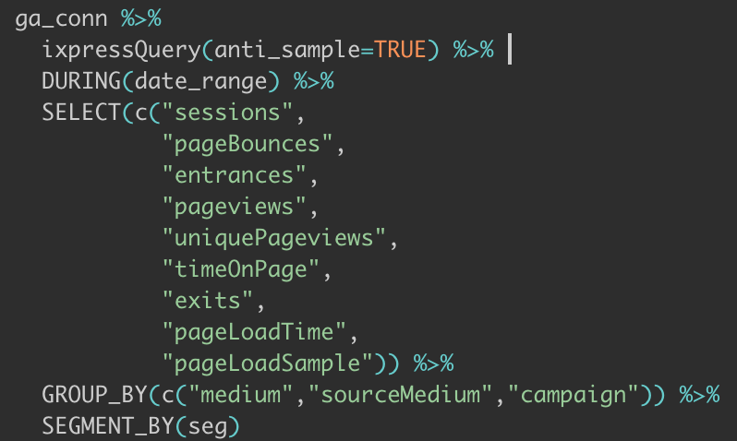
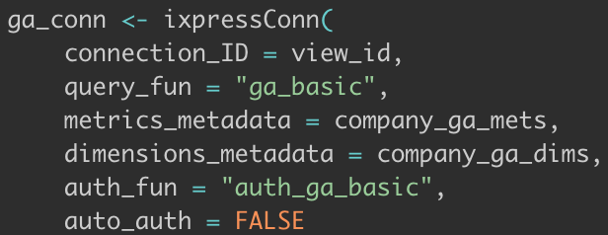
Setting up queries for data acquisition
Note: some data is automatically queried
It gets ingested into cloud storage (S3 buckets) in AWS (Amazon Web Services)
Querying an Application Programming Interface (API)
Use SQL-style queries within R or Python to pull desired data
Choose metrics (SELECT), dimensions (GROUP_BY), segments (SEGMENT_BY), and filters (FILTER)
Notes:
Mention the additional lift of setting up the connection and how filters work slightly differently

Slide 7
Statistical methodologies
Breadth of work is broad and often client-dependent
Visualization
Descriptive Statistics
Inference and Estimation
Modeling
Notes:
Mention how work is usually a combination of several of these and also includes takeaways and recommendations pertaining to relevant business questions

Slide 8
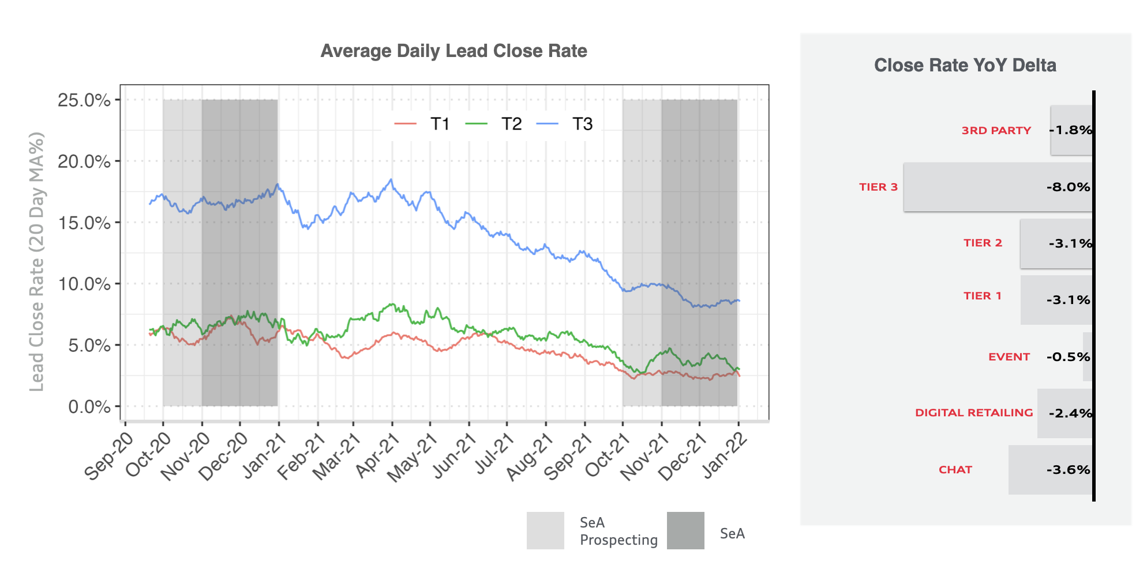
Statistical methodologies
Breadth of work is broad and often client-dependent
Visualization
Descriptive Statistics
Inference and Estimation
Modeling
Notes:
Trends, Year-over-year change, moving average

Slide 9
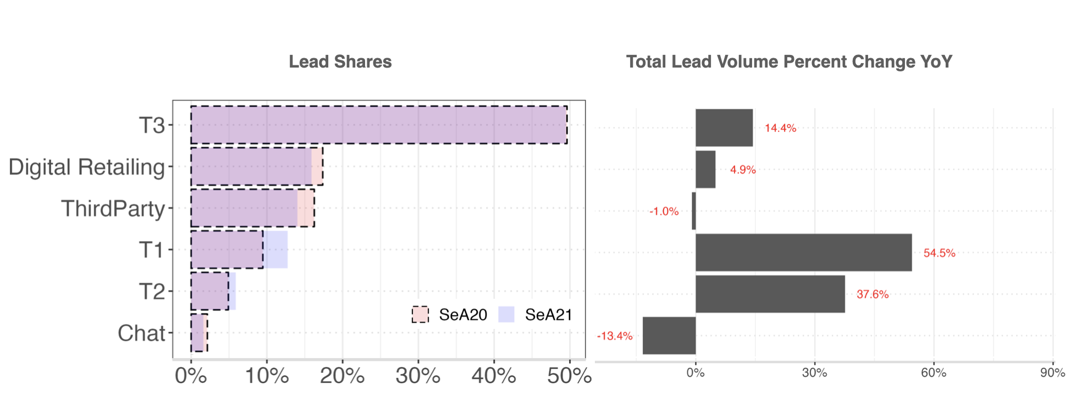
Statistical methodologies
Breadth of work is broad and often client-dependent
Visualization
Descriptive Statistics
Inference and Estimation
Modeling
Notes:
Aggregate percentages or percent change YoY; mention how we sometimes throw error bars on bar charts for added insights

Slide 10
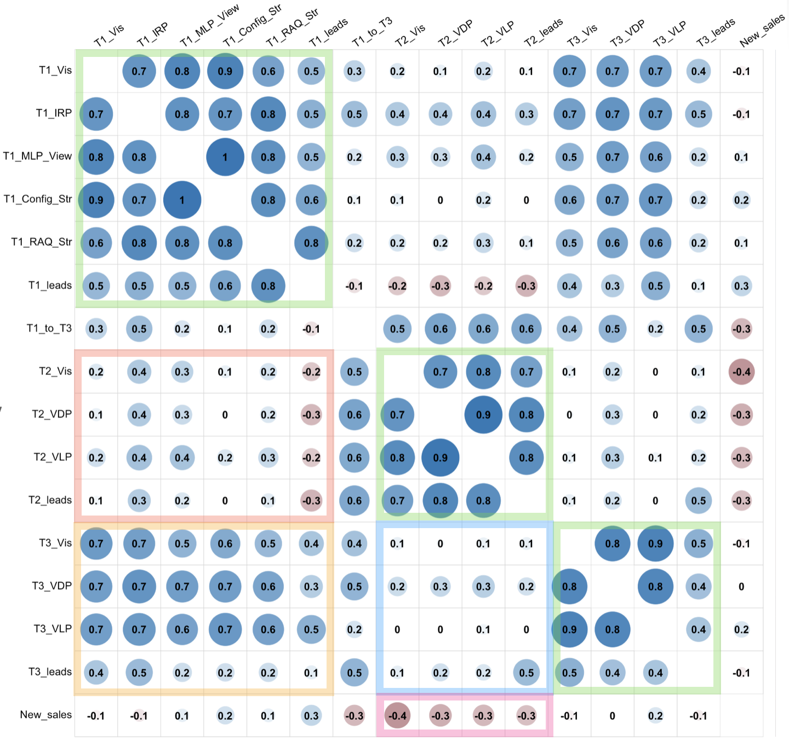
Statistical methodologies
Breadth of work is broad and often client-dependent
Visualization
Descriptive Statistics
Inference and Estimation
Modeling
Notes:
Correlational behavior over time; ordered through hierarchical clustering

Slide 11
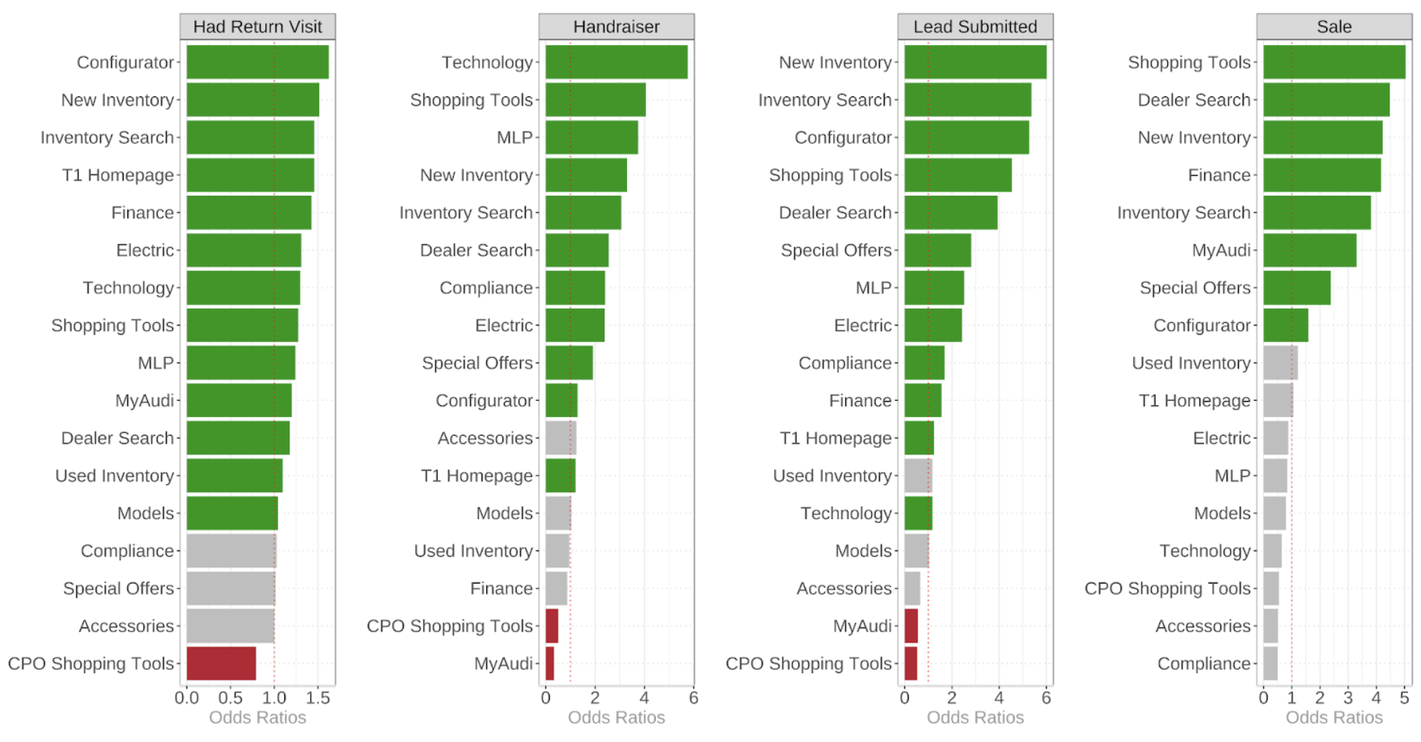
Statistical methodologies
Breadth of work is broad and often client-dependent
Visualization
Descriptive Statistics
Inference and Estimation
Modeling
Notes:
Here we have calculated odds ratios and tested for statistical significance

Slide 12
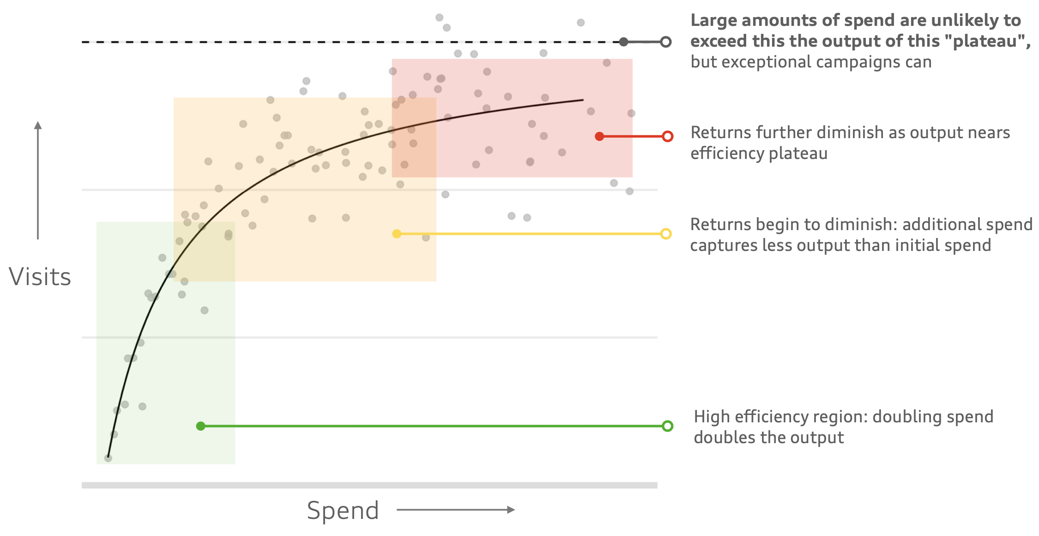
Statistical methodologies
Breadth of work is broad and often client-dependent
Visualization
Descriptive Statistics
Inference and Estimation
Modeling

Slide 13
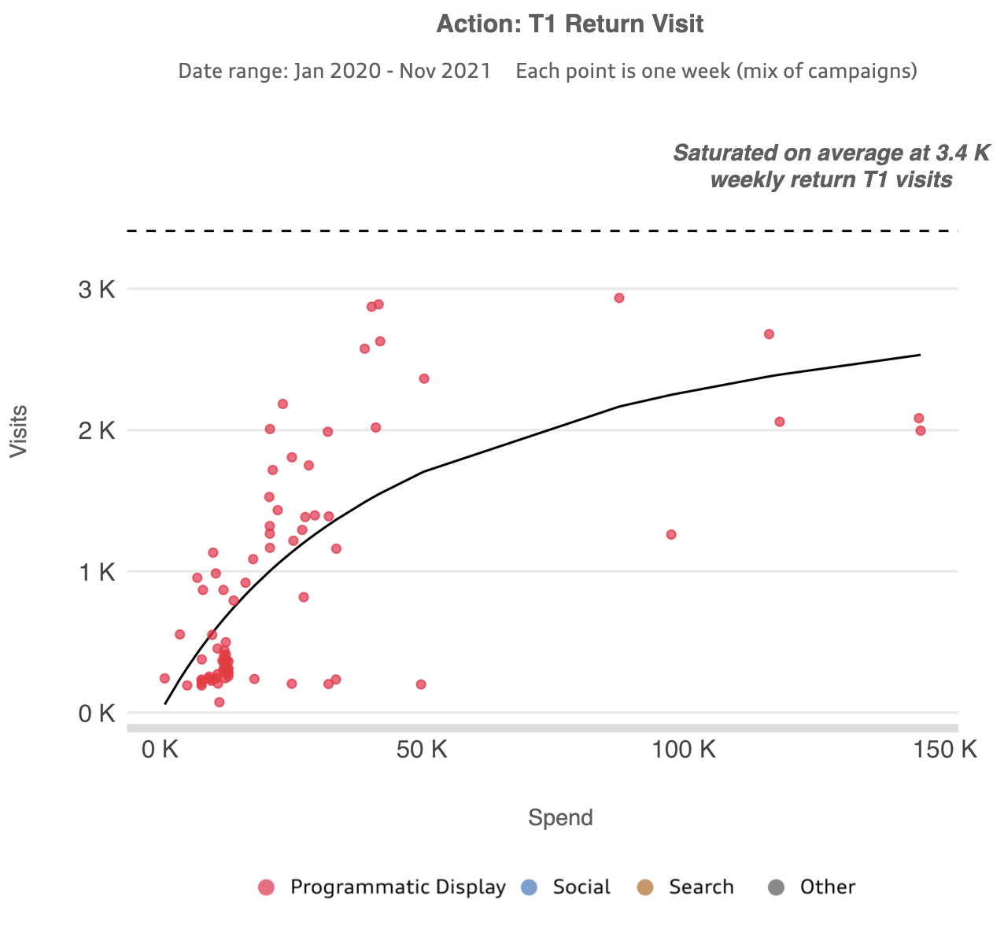
Statistical methodologies
Breadth of work is broad and often client-dependent
Visualization
Descriptive Statistics
Inference and Estimation
Modeling

Slide 14
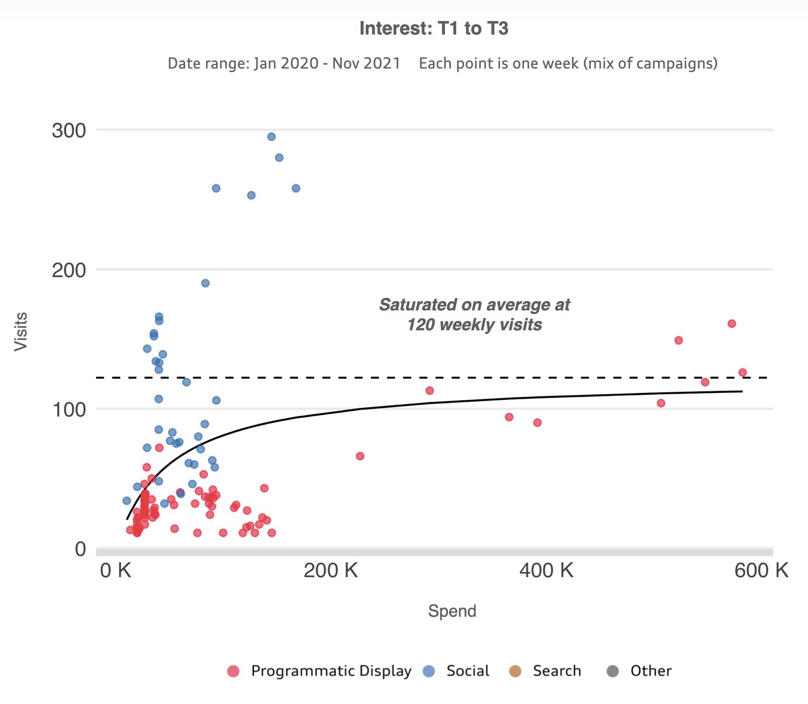
Statistical methodologies
Breadth of work is broad and often client-dependent
Visualization
Descriptive Statistics
Inference and Estimation
Modeling
Notes:
Segue into an overview of the types of analyses; highlight that all so far have been either ad hoc or small components of regular reports (cross-agency or seasonal campaign review)

Slide 15
In-depth Analyses (in brief)
Ad hoc analyses to investigate key performance indicators (KPIs) behavior
Assess the impact of ad spend on KPIs
Volume of traffic, engagement, leads, sales, etc.
Compare across campaigns, channels, and along different funnel stages
Analyze customer lifetime value (CLV)
Estimate purchases expected for particular a customer segment
Assess impact of type of first purchase on subsequent purchases and behavior
Automated reporting
Provide regular deliverables that track core metrics to give immediate insight
A/B Testing
Compare page and product performances before/after updates, new releases, etc.
Determine the relative success of each model
Notes:
By no means exhaustive!

Slide 16
Technical coding workflow
Work done within shared repositories (repos) – we maintain one for each client
Sub-folders broken out for automated tasks versus ad hoc analyses
Data, documentation, figures, and code
Code typically broken out in a consistent format
Initialization (init), utility functions (util), segments, query, query processing, analysis,visualization, etc.
Automated code: Dockerized, Fargate job deployed, and cron job Lambda event triggered
Work housed in S3 in AWS
Generally working on project-specific or coder-specific branches
Maintain a git workflow of pulling, committing, and pushing as is appropriate
All client-facing work is QCed by another data analyst/scientist as well as a graphic designer

Slide 17
Courses and Experiences useful for professional development
Courses
Probability and Statistics for Engineering (STAT 383)
Advanced Applied Statistics (STAT 584)
Probability and Statistics for Analytics (IA 530)
Info Visualization (IA 640)
Mathematical Statistics (STAT 582)
Special Projects in Economics (EC 687)
Experiences
R, LaTeX, Python, SQL
git branching/sharing
regex
Collaborative research projects
Group research experiences
Presentations, visualizations, papers
Resume review, career fair, interviews
Notes:
Mention datacamp.com; clarify special projects was econometrics

Slide 18
Questions
Thank you for your time!

