Slide 1
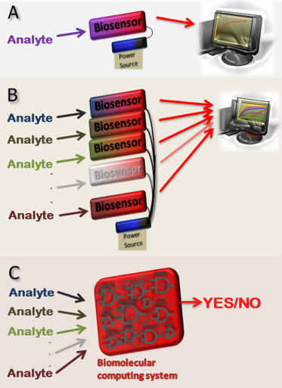
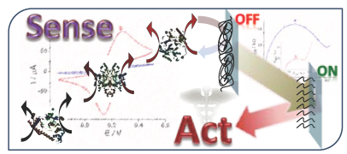
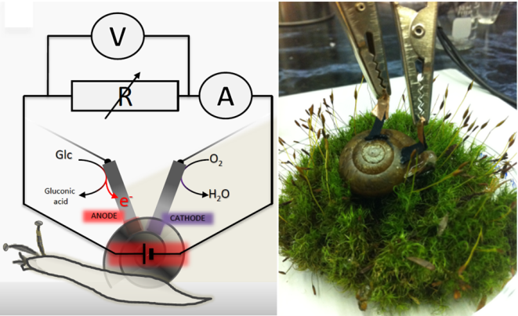
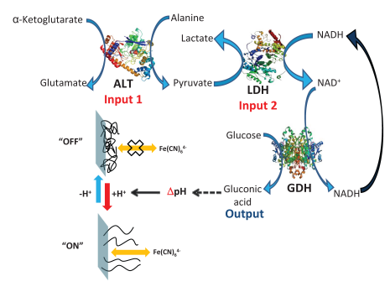
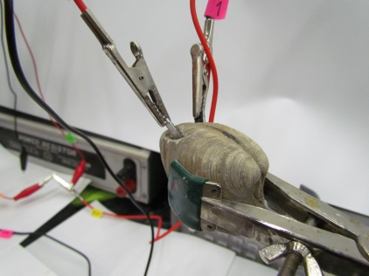
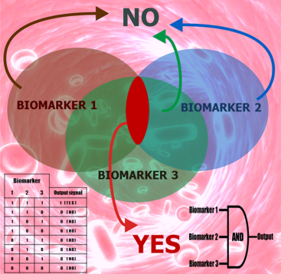
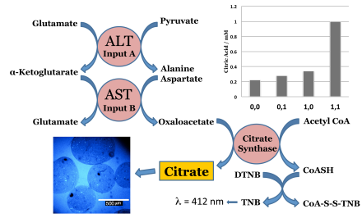
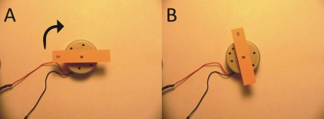
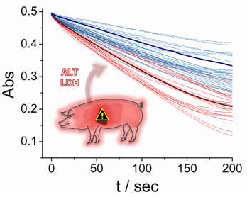
Bioelectronics: From Novel Concepts to Practical Applications
Professor Evgeny Katz
Department of Chemistry and Biomolecular Science Clarkson University, Potsdam NY 13699-5810, USA; ekatz@clarkson.edu; http://people.clarkson.edu/~ekatz/
Multi-input Biosensors with Built-in Logic for Medical Diagnostics
“Smart” Materials and Interfaces Switchable by Biological Signals
Implanted Biofuel Cells Operating in Vivo
Novel biosensors digitally process multiple biochemical signals through Boolean logic networks of coupled biomo-lecular reactions and produce output in the form of YES/NO response. Compared to traditional single-analyte sensing devices, biocompu-ting approach enables a high-fidelity multi-analyte biosen-sing, particularly beneficial for biomedical applications. Multi-signal digital bio-sensors thus promise advances in rapid diagnosis and treatment of diseases by processing complex patterns of physiological biomarkers. Specifically, they can provide timely detection and alert to medical emergencies, along with an immediate thera-peutic intervention. Applicati-on of biocomputing concepts has been successfully demon-strated for systems for logic analysis of biomarkers of different injuries, particularly exemplified for liver injury. Wide-ranging applications of multi-analyte digital biosen-sors in medicine, environ-mental monitoring and homeland security are anticipated.
Stimuli-responsive materials and interfaces were functionally integrated with biomolecular information processing systems allowing biological control over bioelectronic / biomedical devices.
Liver injury biomarkers alanine transaminase (ALT) and lactate dehydrogenase (LDH) working cooperatively resulted in pH changes switching an electrochemical interface from OFF to ON state. The electrode activated by the injury biomarkers can operate as a biosensor or can be integrated in a switchable biofuel cell.
M. Privman, T.K. Tam, V. Bocharova, J. Halámek, J. Wang, E. Katz, Responsive interface switchable by logically processed physiological signals – Towards “smart” actuators for signal amplification and drug delivery.
ACS Appl. Mater. Interfaces 2011, 3, 1620-1623.
Similar approach was applied to trigger drug release from microspheres upon concerted operation of two injury biomarkers. A biocatalytic cascade activated by the biomarkers resulted in a drug release only when all biomarkers are present mimicking a Boolean AND logic gate. The “Sense-Act-Treat” biocomputing system will be able to autonomously correlate the relationship between different biomedically-relevant markers according to “programmed” Boolean logic operations and regulate the release of a target drug to counteract the onset of abnormal physiological states.
Biofuel cell implanted in a snail provided sustainable electrical power generated from naturally produced glucose.
L. Halámková, J. Halámek, V. Bocharova, A. Szczupak, L. Alfonta, E. Katz, Implanted biofuel cell operating in living snail. J. Am. Chem. Soc. 2012, 134, 5040-5043.
Biofuel cells implanted in living clams and producing sustainable electrical power in vivo were integrated in batteries with a serial or parallel circuitry, thus increasing the power output.
A. Szczupak, J. Halámek, L. Halámková, V. Bocharova, L. Alfonta, E. Katz, Living battery – Biofuel cells operating in vivo in clams. Submitted for publication.
The power produced by the “living batteries” was enough to rotate a DC electrical motor.
Complex patterns of biomarkers
Combination of biomarkers
The work was highlighted by many newspapers, radio, TV and web sites.
Liver injury biomarker analysis in the animal model
Released drug

