Slide 1
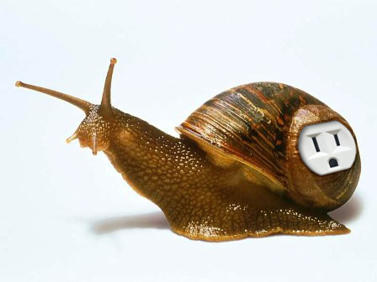
Living battery - biofuel cells operating in vivo
Evgeny Katz
Department of Chemistry & Biomolecular Science, Clarkson University, Potsdam, NY, USA
Workshop on ‘Synergies between Semiconductors and Synthetic Biology’ (SemiSynBio) – February 22-23, 2013

Slide 2
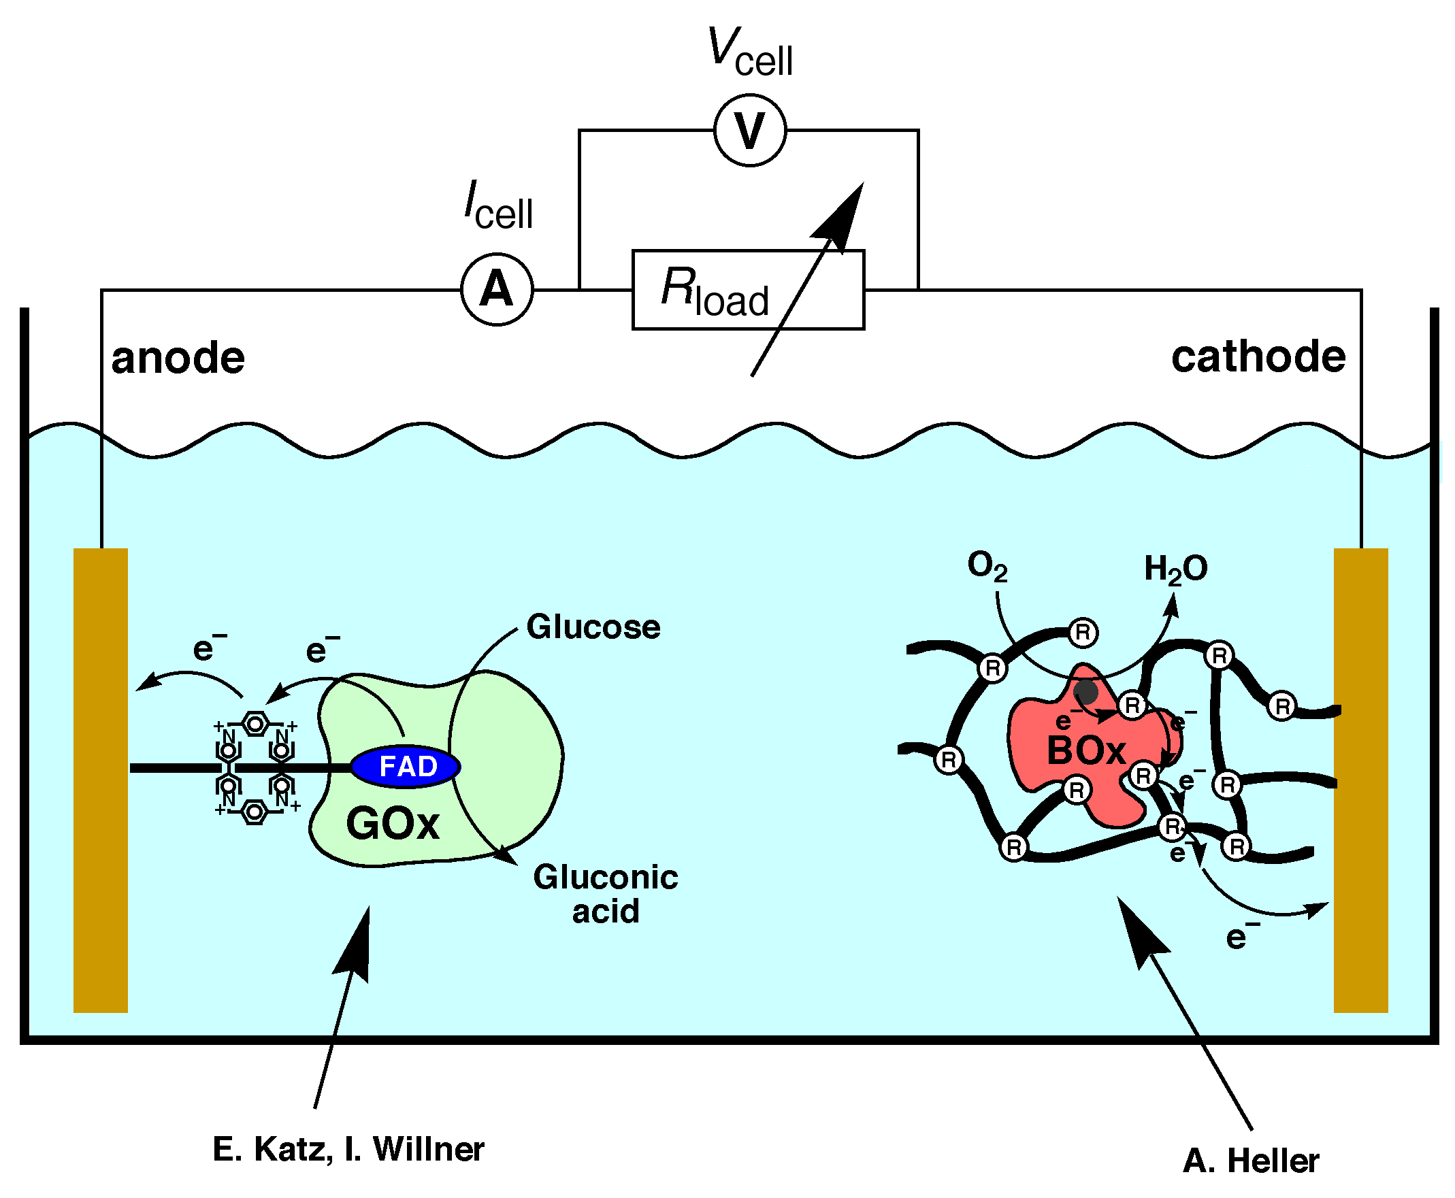
Enzyme-Based Biofuel Cells
Anode example
Cathode example

Slide 3
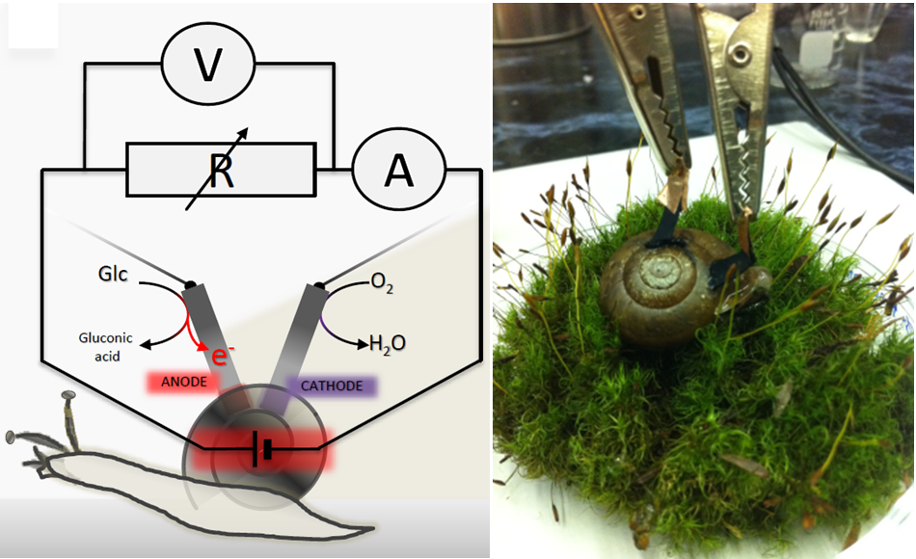
Biofuel cell implanted in snail for in vivo operation
L. Halámková, J. Halámek, V. Bocharova, A. Szczupak, L. Alfonta, E. Katz, J. Am. Chem. Soc. 2012, 134, 5040-5043.

Slide 4
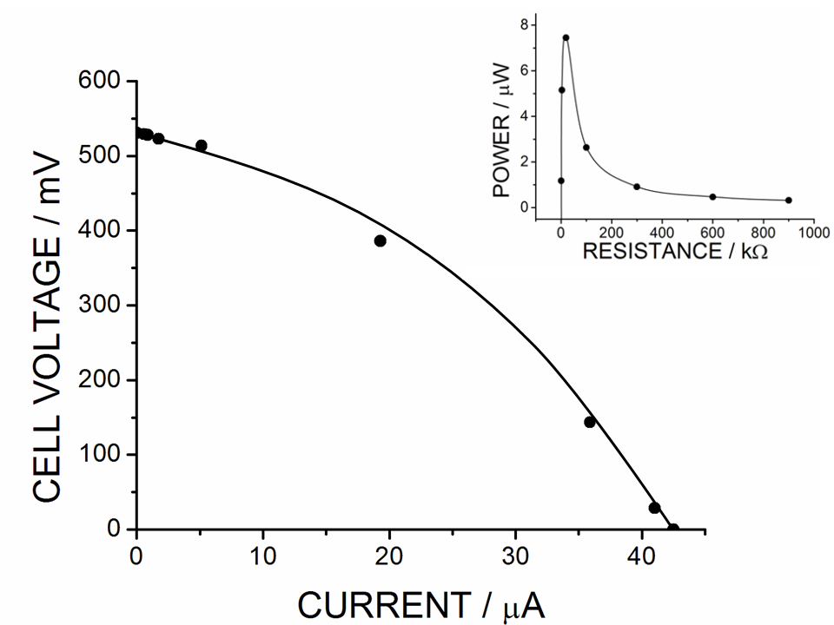
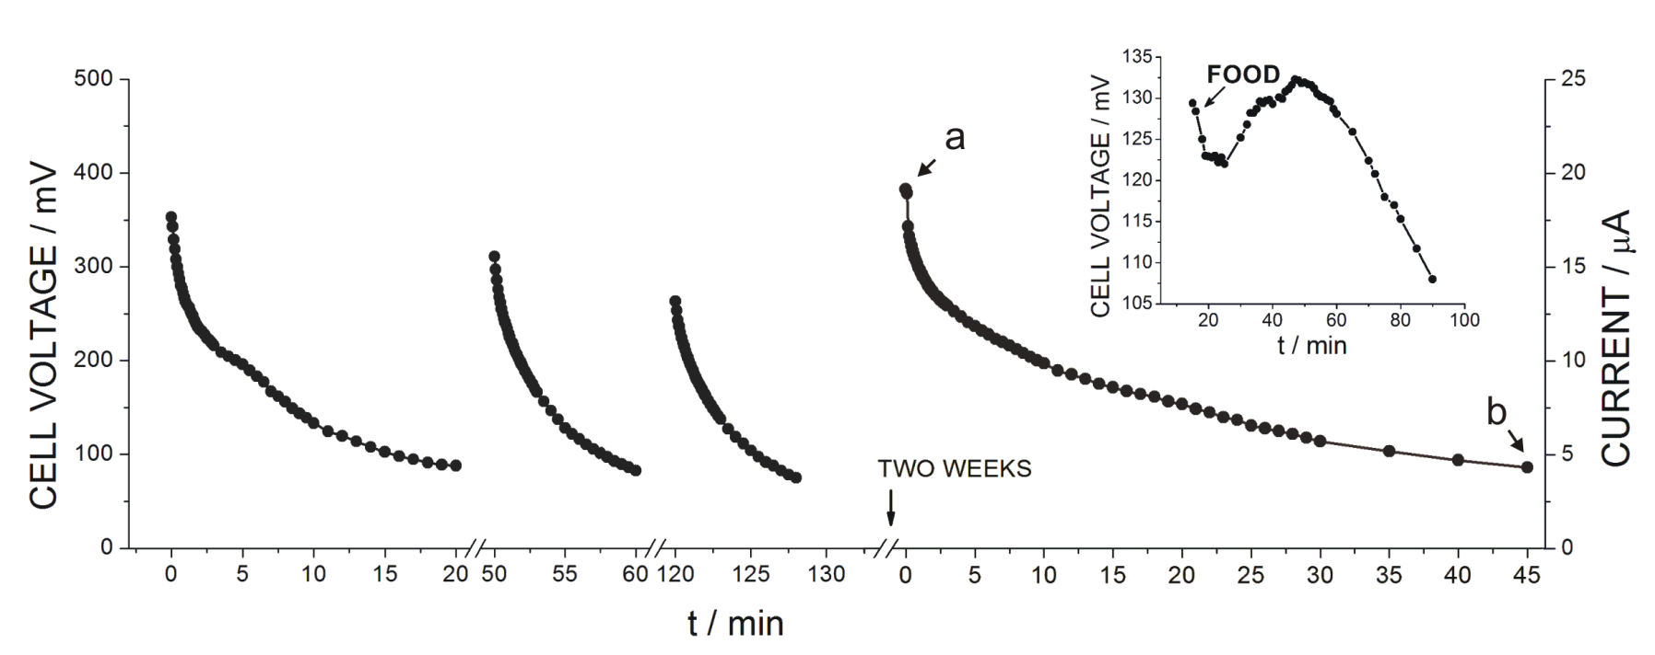

Slide 5
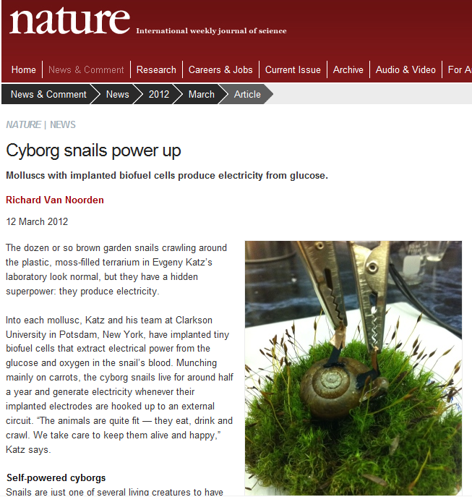

Slide 6
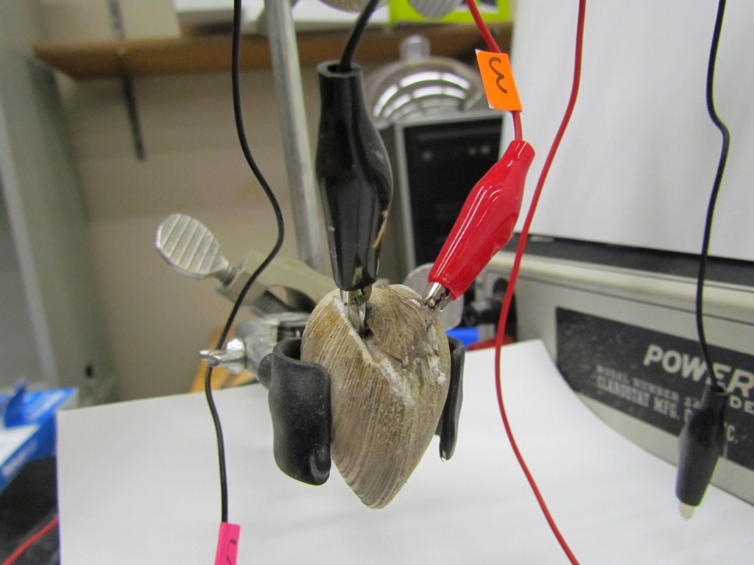
Biofuel cell implanted in clam for in vivo operation
A. Szczupak, J. Halámek, L. Halámková, V. Bocharova, L. Alfonta, E. Katz,
Energy & Environmental Science 2012, 5, 8891-8895.

Slide 7
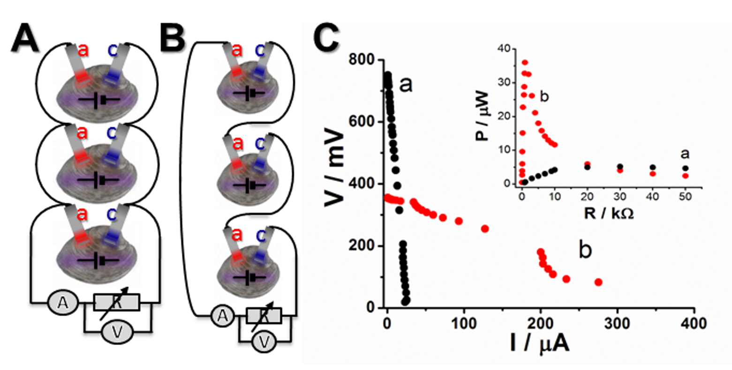
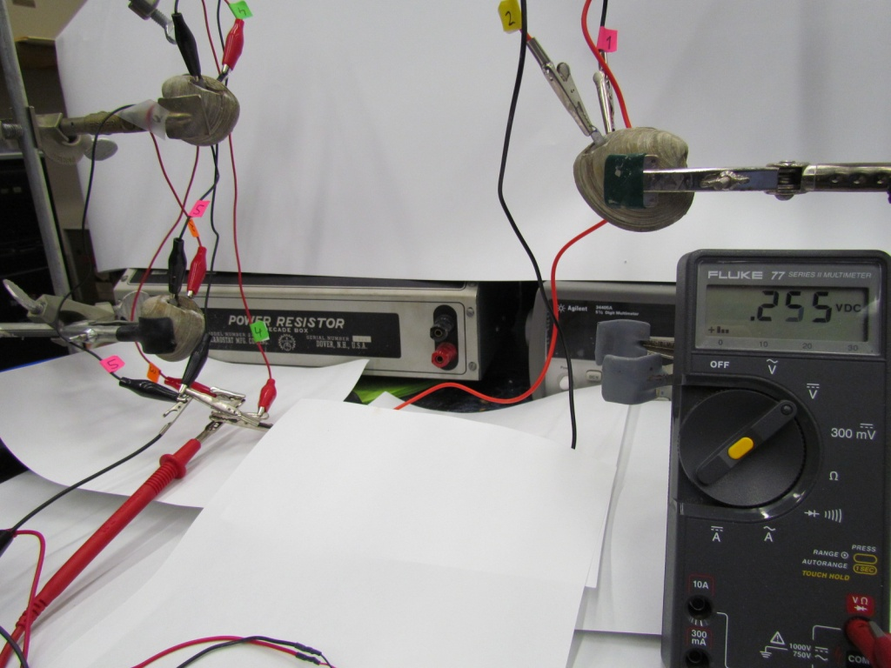

Slide 8
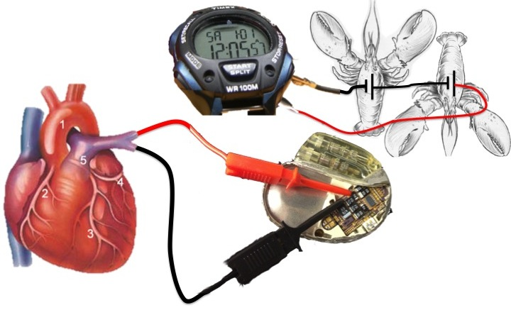
Getting electrical power for activating electronic devices: From the animal research to biomedical applications
K. MacVittie, J. Halámek, L. Halámková, M. Southcott, W.D. Jemison, R. Lobel, E. Katz, Energy & Environmental Science 2013, 6, 81-86.

Slide 9
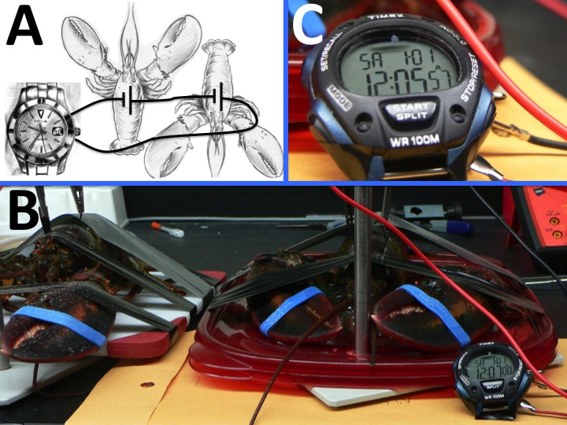
Activation of a digital watch (as a model device) by the implanted biofuel cells

Slide 10
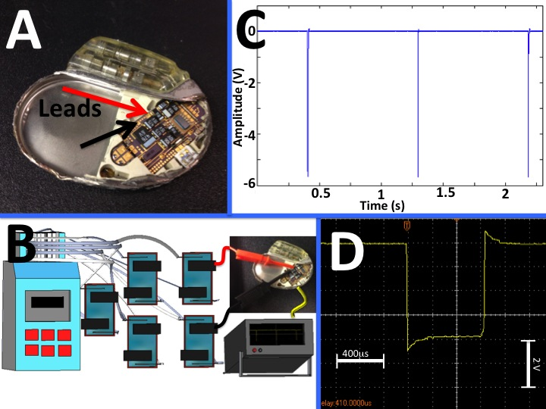
Activation of a pacemaker by the implantable biofuel cells mimicking human physiology

Slide 11
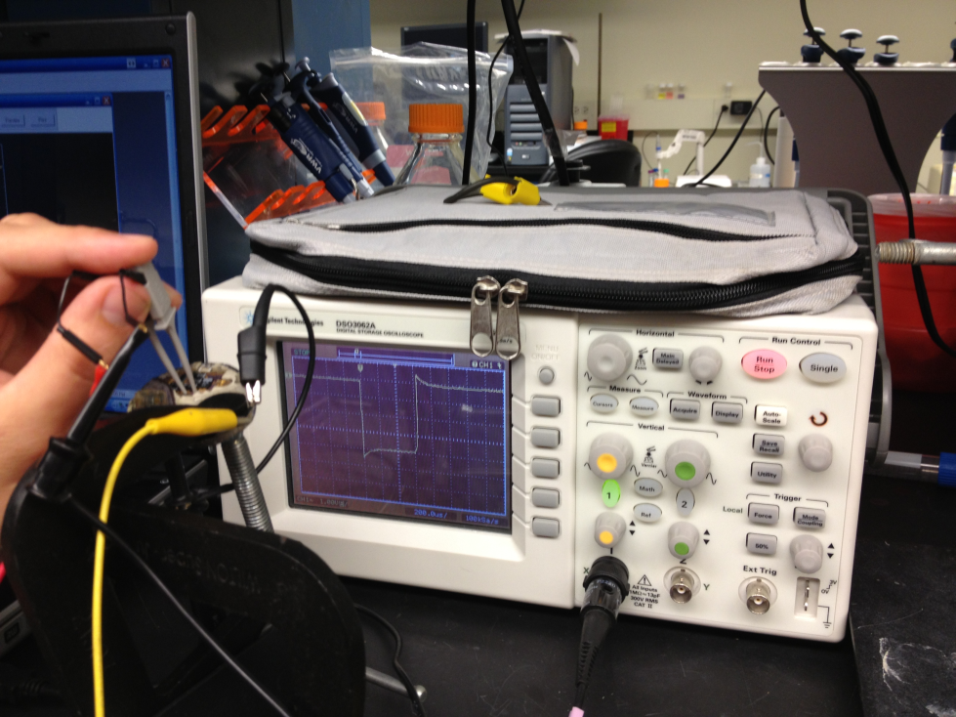
Good news – the pacemaker operation was perfect !!!

Slide 12
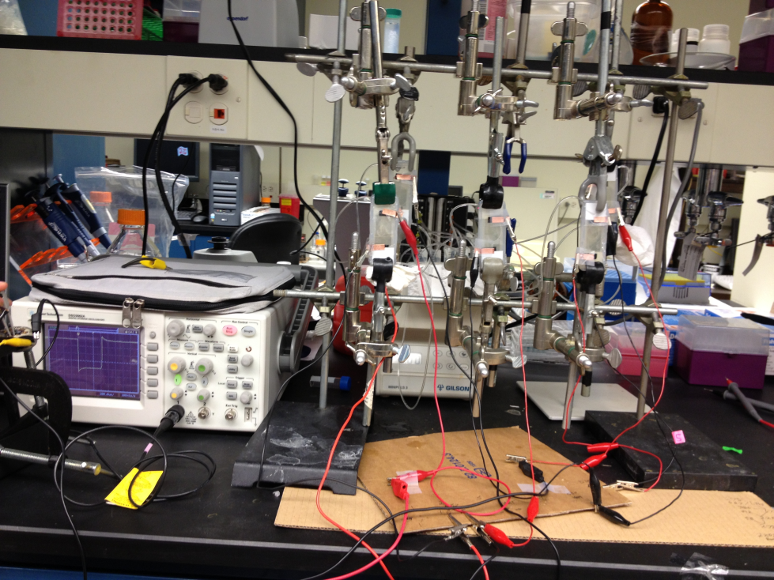
Bad news – the system included 5 biofuel cells with serial connection

Slide 13
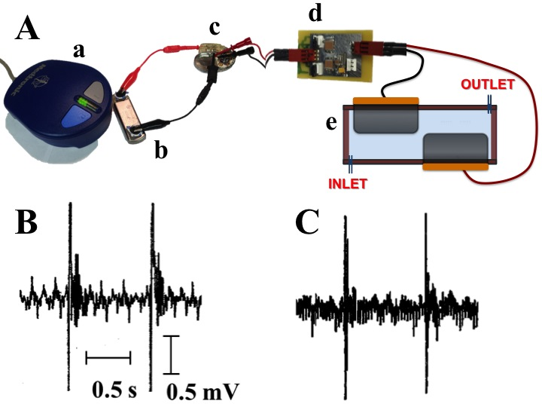
Powering pacemaker from a single implantable biofuel cell through a charge pump
Standard battery
Biofuel cell
(A) Experimental setup which includes (from left to right): (a) sensor device for the Medtronic CareLink Programmer, Model 2090, (b) Medtronic Reveal XT, Model 9529, implantable loop recorder (ILR), (c) Affinity DR 5330L, St. Jude Medical, pacemaker, (d) the charge pump–DC-DC interface circuit, (e) the flow biofuel cell with the inlet/outlet connected to a peristaltic pump (not shown in the scheme). (B) Registered pulses generated by the pacemaker when it is powered by the standard battery. (C) Registered pulses generated by the pacemaker when it is powered by the biofuel cell.

Slide 14
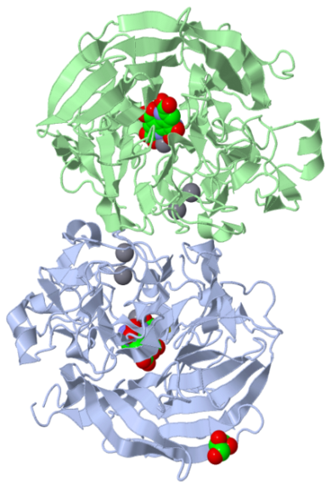
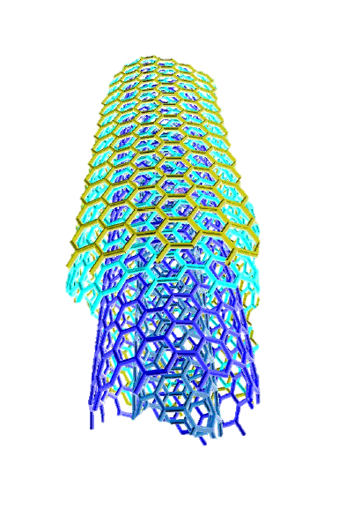
Bioelectrocatalytic electrodes operating in vivo can be used for many different bioelectronic and biosensor applications
Fuel
Power from biofuel cell
O
Electrode
C
NH
Information from biosensor
Analyte

Slide 15
The research is supported by:

Slide 16
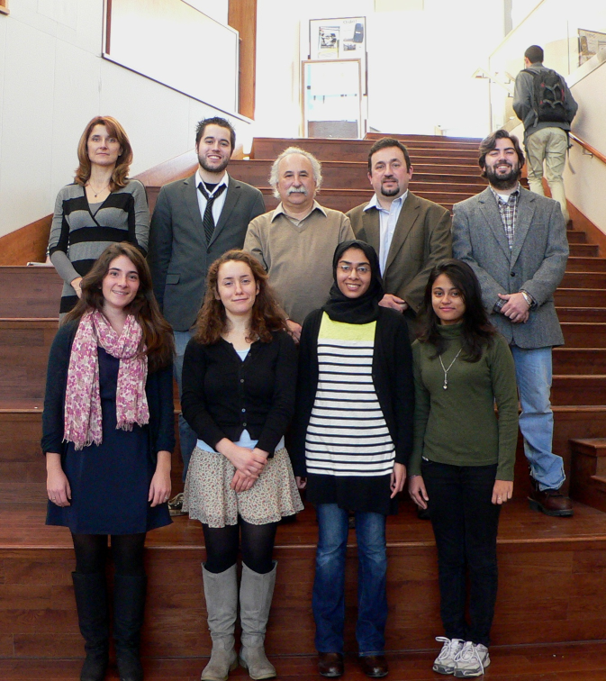
Bioelectronics & Bionanotechnology group of Prof. Evgeny Katz, Clarkson University

Slide 17
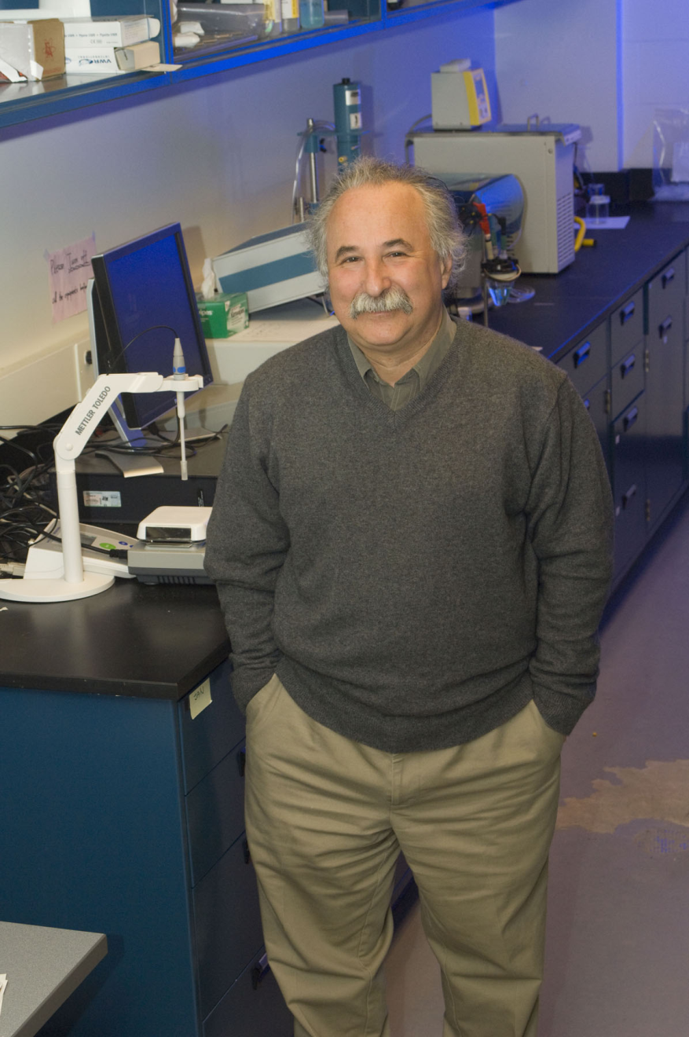
Thank you! Any questions?
Evgeny Katz, Dept. of Chemistry & Biomolecular Science, Clarkson University

